Slide 1
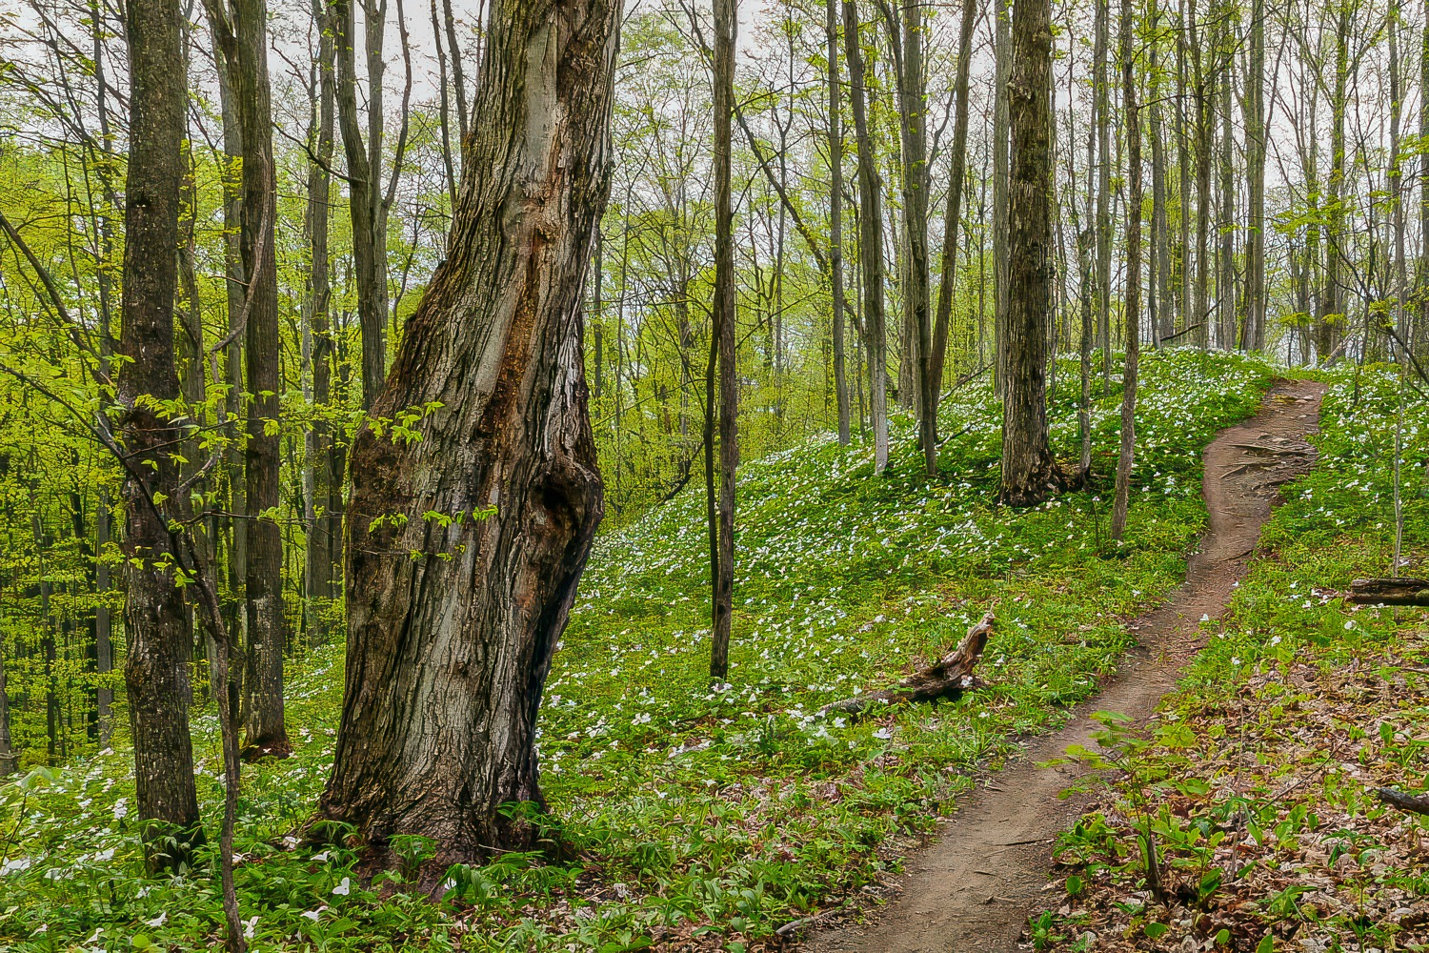
Copeland Forest Friends Association
Looking Ahead
March 27, 2019
Welcome and President’s Report

Slide 2
Welcome
I want to welcome you to our 8th Annual General meeting!
We’re celebrating 10 years since the presentation of the stewardship report to MNRF.
First, I will introduce special guests.
Second, I want the board to stand up

Slide 3
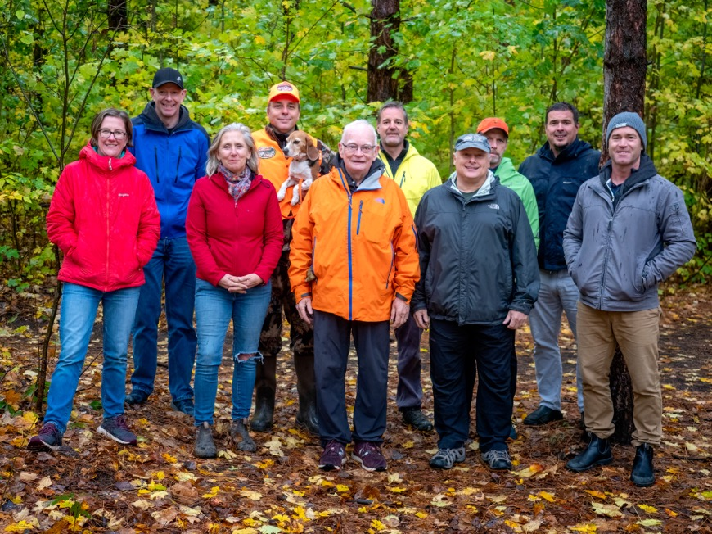
Your Board
2022-23 Board Members
David Kennedy
Len Cater
David Myles
Lisa Banks
Derek Witlib
Kyra Howes
Catherine Blakley
Jenn Copeland
Jamie Herbst
Don McKinnon
Andrew Doble – Horseshoe Resort
2021-22 Board

Slide 4
This Evening’s Agenda
President’s Report – the Past and Future
Trail Committee Report
User Group Meetings
Business Meeting – Financial, Membership, Election Reports
User Group Feedback
Adjournment

Slide 5
Looking Back on 10 Years
It’s now 10 years since we got the go-ahead to take care of the Forest.
Presentation of Stewardship Recommendations to Ministry, 2013

Slide 6
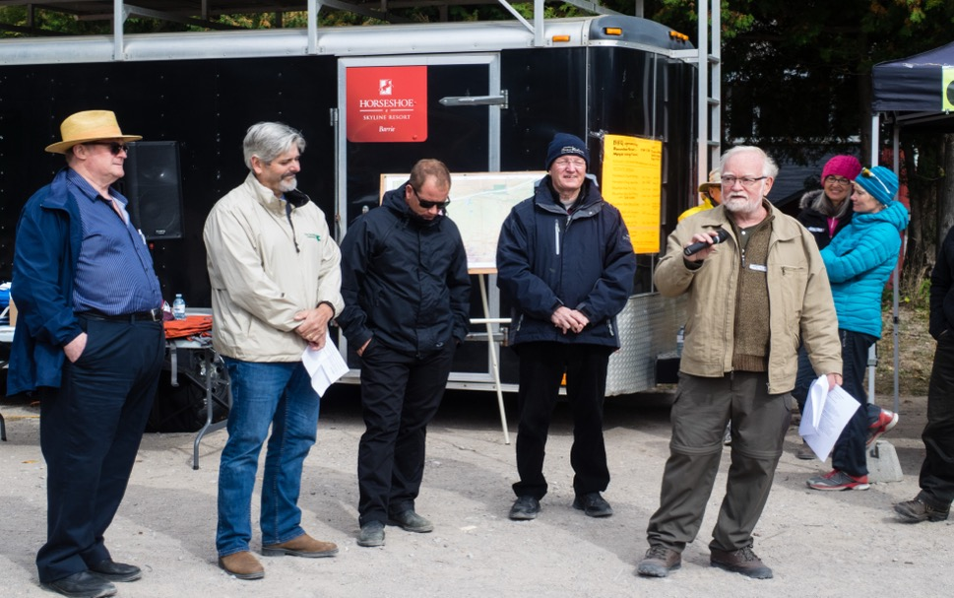
Looking Back on 10 Years
It’s now 8 years since the Association was established. Launched at Fall Fair Sept. 2015
Launch Event
. Scott MacPherson - Oro-Medonte
. Mark Bisset - Couchiching Conservancy
. Johnathan Reid – Horseshoe Resort
. Harry Hughes, Oro-Medonte
. David Kennedy – Copeland Forest Friends

Slide 7
Accomplishments
Let’s take a look back and celebrate our achievements over the past ten years
These achievements took many people and many hours working together to:
  Protect and preserve this beautiful forest
  And at the same time
  Support safe recreational opportunities.

Slide 8
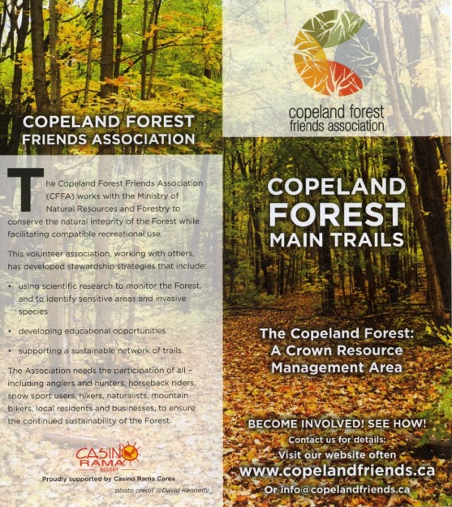
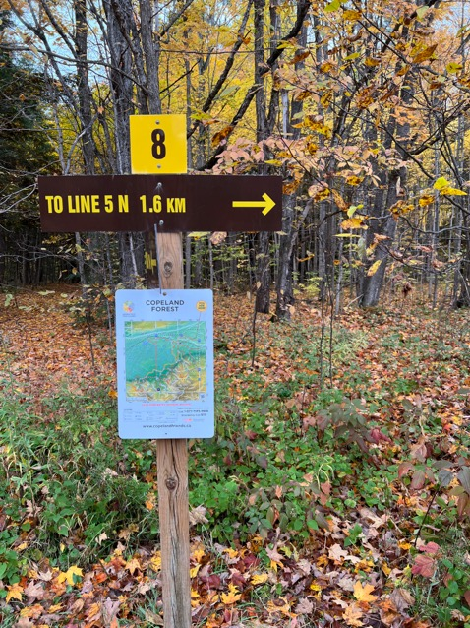
Maps and Signage
One of our first projects was to introduce the first published map of the Copeland Forest and signage at the main trail heads and key intersections.

Slide 9
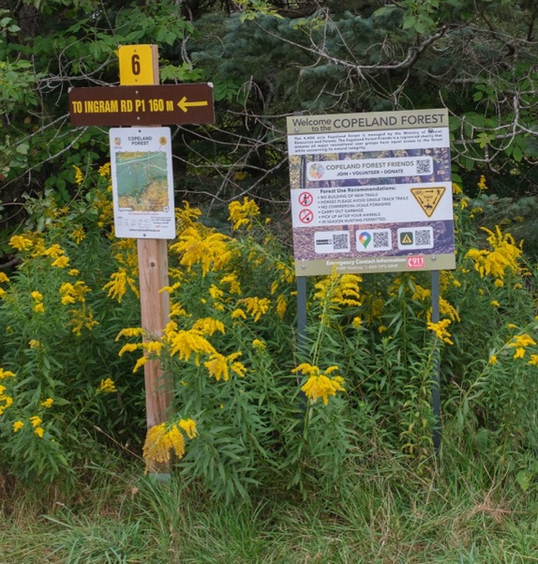
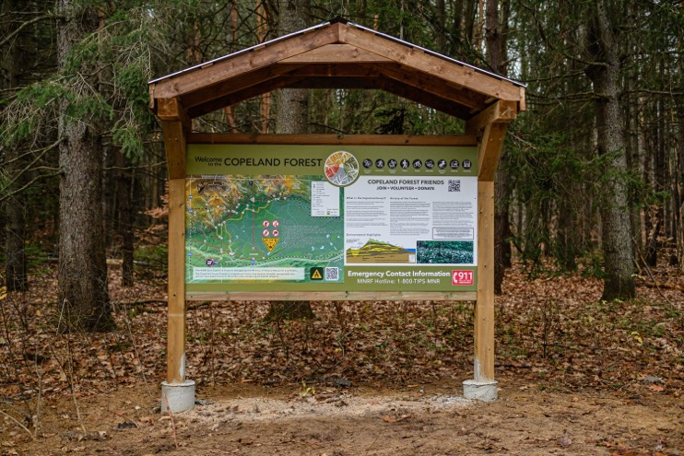
Enhanced Signage
We have enhanced the signage to provide more guidance for users. Thanks to Brad Turner for his leadership on this.

Slide 10
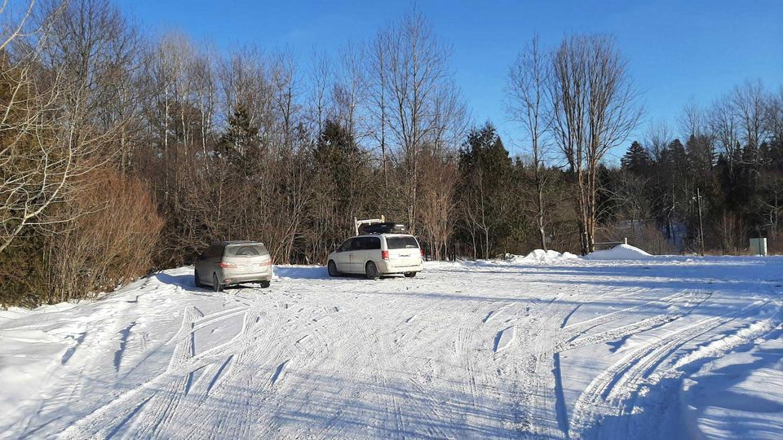
Ingram Rd Parking
We are now clearing the snow at both parking lots with funding from the Township of Oro-Medonte, the Ganaraska Hiking Trail Association, the CFFA core budget and private donations. Thanks to all!

Slide 11

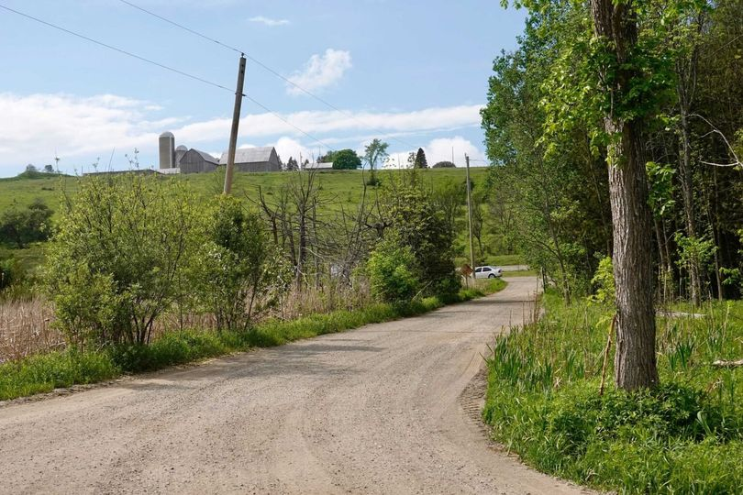

Ingram Rd Parking - Grading
The Township of Oro Medonte has facilitated grading of the two parking lots on Ingram Road for two years now. Thanks to Georgian Paving for its contribution.

Slide 12
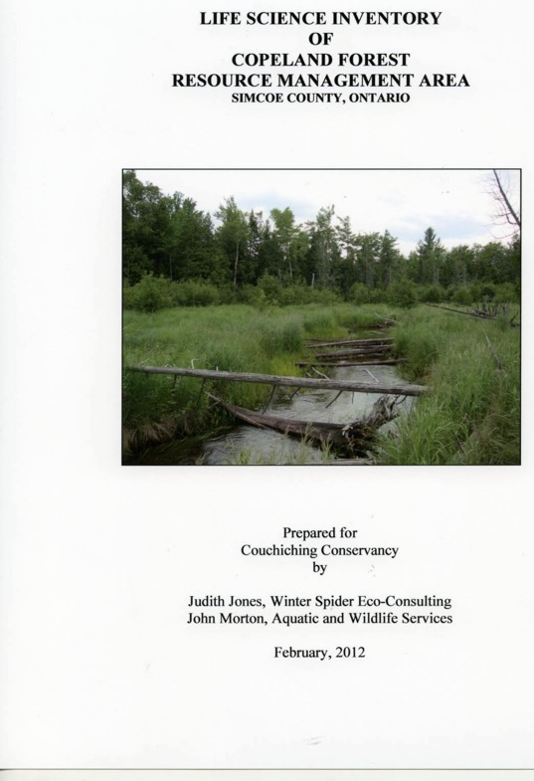
Ecology and Sustainability Report 2012 - a foundation for all our work
We started with the 4-season biological inventory prepared for the Couchiching Conservancy.
Thanks to the Conservancy for leadership in getting us started and the continuing support for our ecology projects.
Thanks too to Dorothea Hangaard, our project manager, and now executive director of the Conservancy.

Slide 13
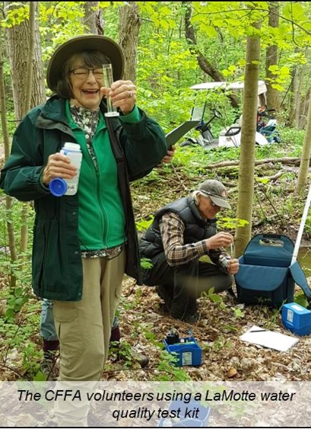
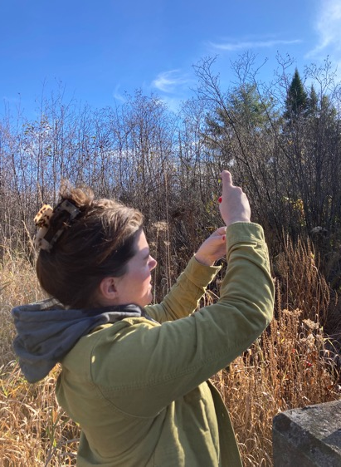
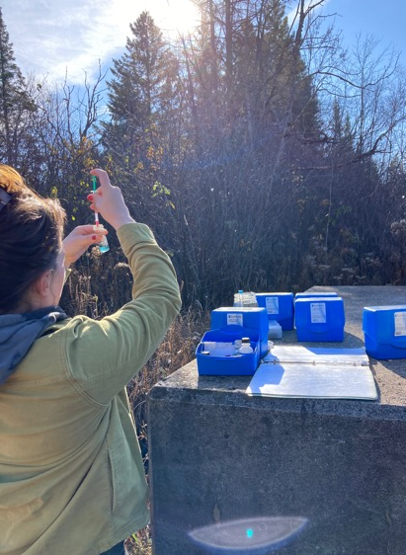
Water Testing – Involving Volunteers
7 Years ago, we started water testing to monitor water quality in the Copeland Forest.
Working with the Severn Sound Environmental Association and Couchiching Conservancy. Thanks to the 14 volunteers!

Slide 14
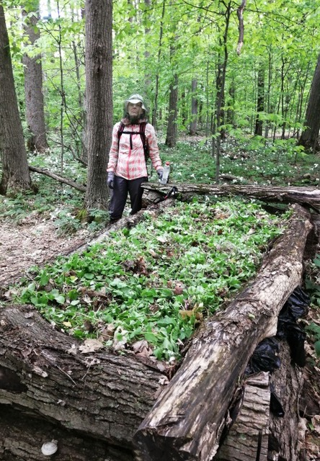
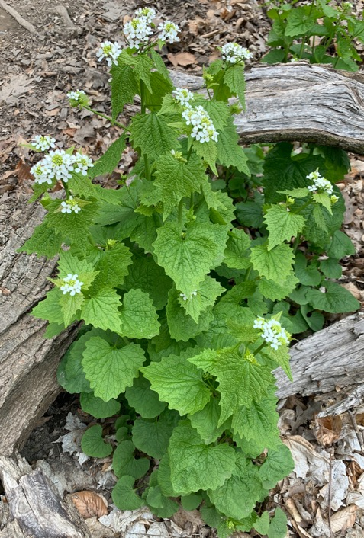
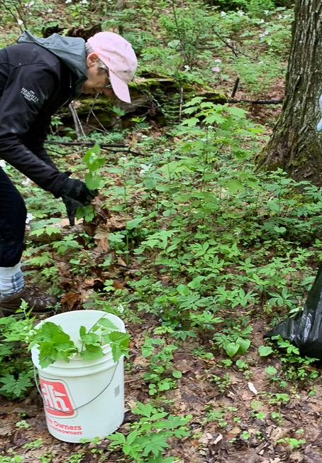
Volunteers - Garlic Mustard Control
5 Years ago, we started a project to control the spread of garlic mustard. David Hawke sees it is having a positive impact.
Over 50 volunteers involved last year. Protecting both the forests and its wildlife.

Slide 15
Ecological Assessment of Trails
For the Trail Committee, we contracted with David Hawke to do an Ecological Assessment of the Copeland Forest Trails.
Don McKinnon will highlight this report in his presentation next.

Slide 16
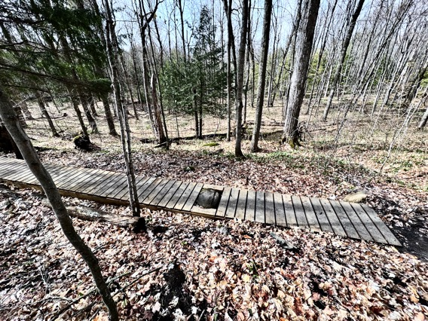
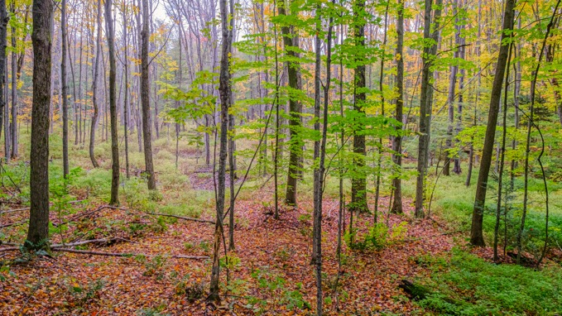
Re-routing Trails out of sensitive areas. We have moved several trails out of wet areas.
2016 Trail Re-route The Result Now

Slide 17
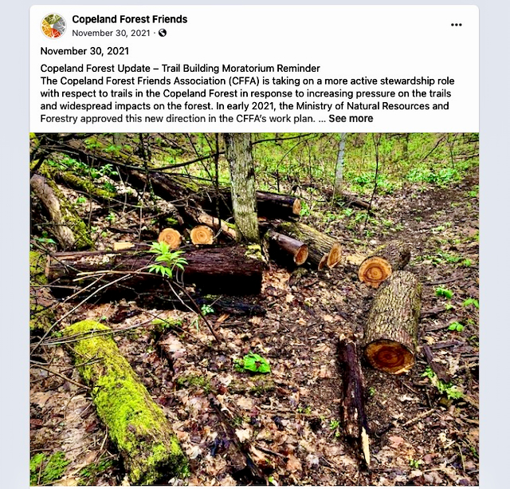
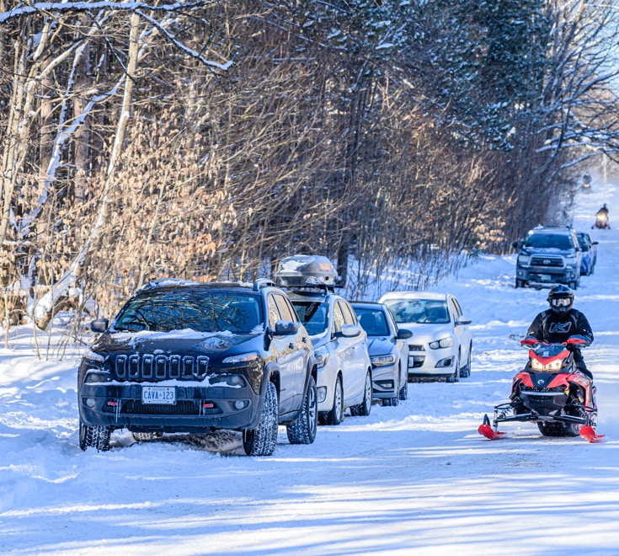
Trails – Increasing Pressure – Need to Review Trails

Slide 18
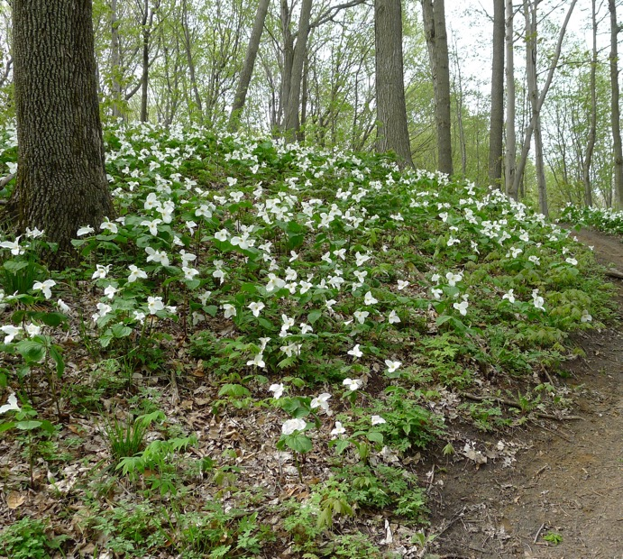
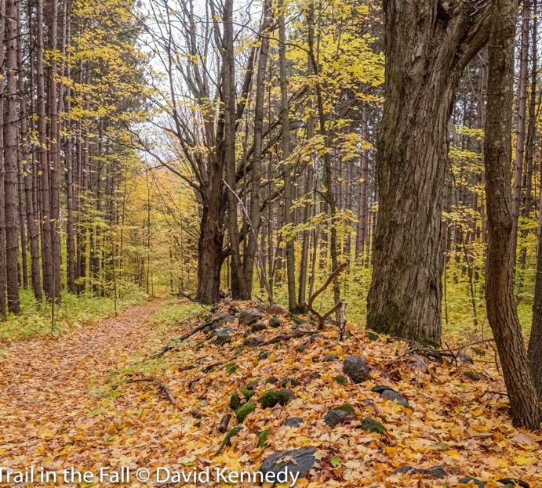
Trails – Preserve the Forest while supporting trail use

Slide 19
Working Together
We started the Association on the premise that the Forest is open to all users and that we need to all work together to support the stewardship of the Forest.
While we do still have occasional user to user issues, we have all users working together on our projects.
We also have all users talking to each other and working out any issues.
When we work together, we can accomplish so much more.

Slide 20
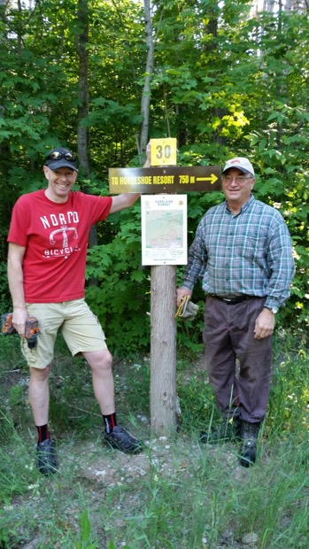
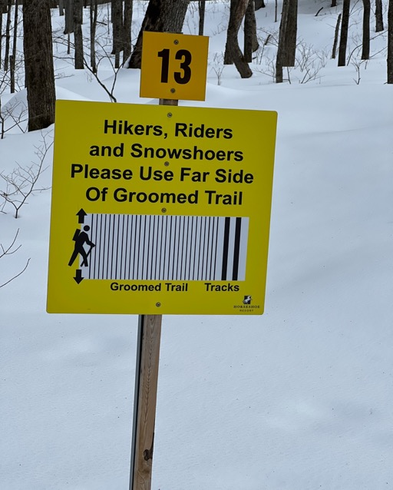
Partnerships – Sharing the Trails in Winter
We have a strong working partnership with Horseshoe Resort. We work together on signage, trail work and special events such as the Fall Fairs and they provide meeting space for the Association.
With the increase in forest use, we worked with Horseshoe Resort to enable winter walkers and snow shoers on the cross- country ski trails.
Andrew Doble
Horseshoe Resort
Neil Craig, Copeland Forest Friends

Slide 21
Looking to the Future
We started up because we knew the Copeland Forest was a jewel on the edge of the Oro Moraine. But that it could be harmed unintentionally by increased use and urban growth.
I am confident that the development of the new trail plan and continued attention to invasive plants and protection of sensitive areas will ensure the health of the Forest and recreational opportunities for all.
Your involvement and support of the Association will be crucial to ensuring this happens.
When a call goes out for volunteers for fund raising, trail work, educational projects, invasive species control, please step up.
Thank you.

Slide 22
Next in the Agenda
We will now hear from the trail committee.
Then, we will break into user groups
Before reconvening for the business meeting.

