Slide 1
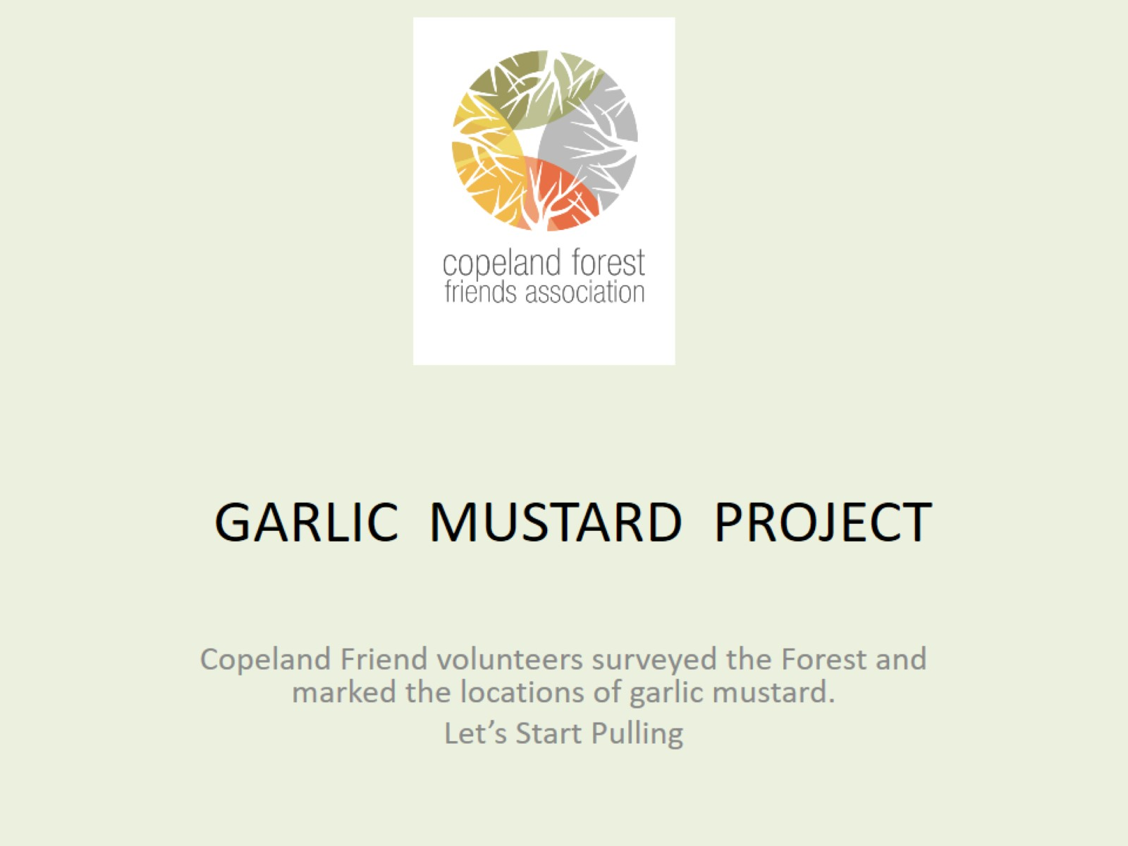
GARLIC MUSTARD PROJECT

Slide 2
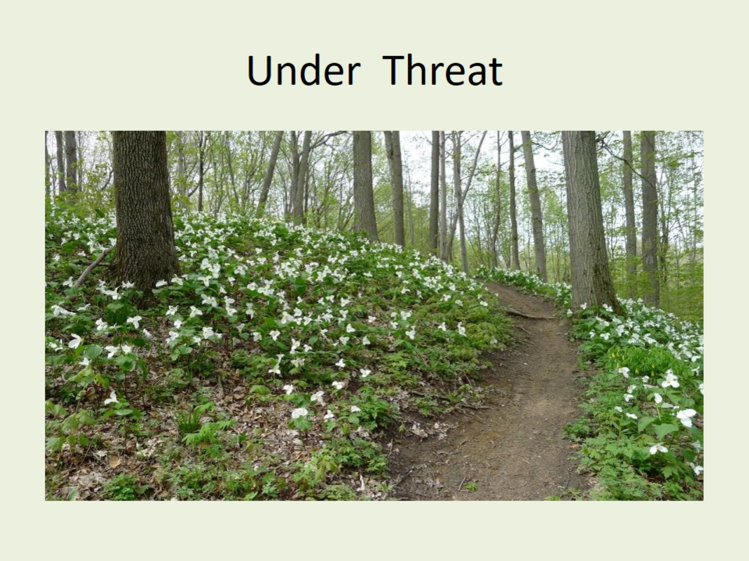
Under Threat

Slide 3
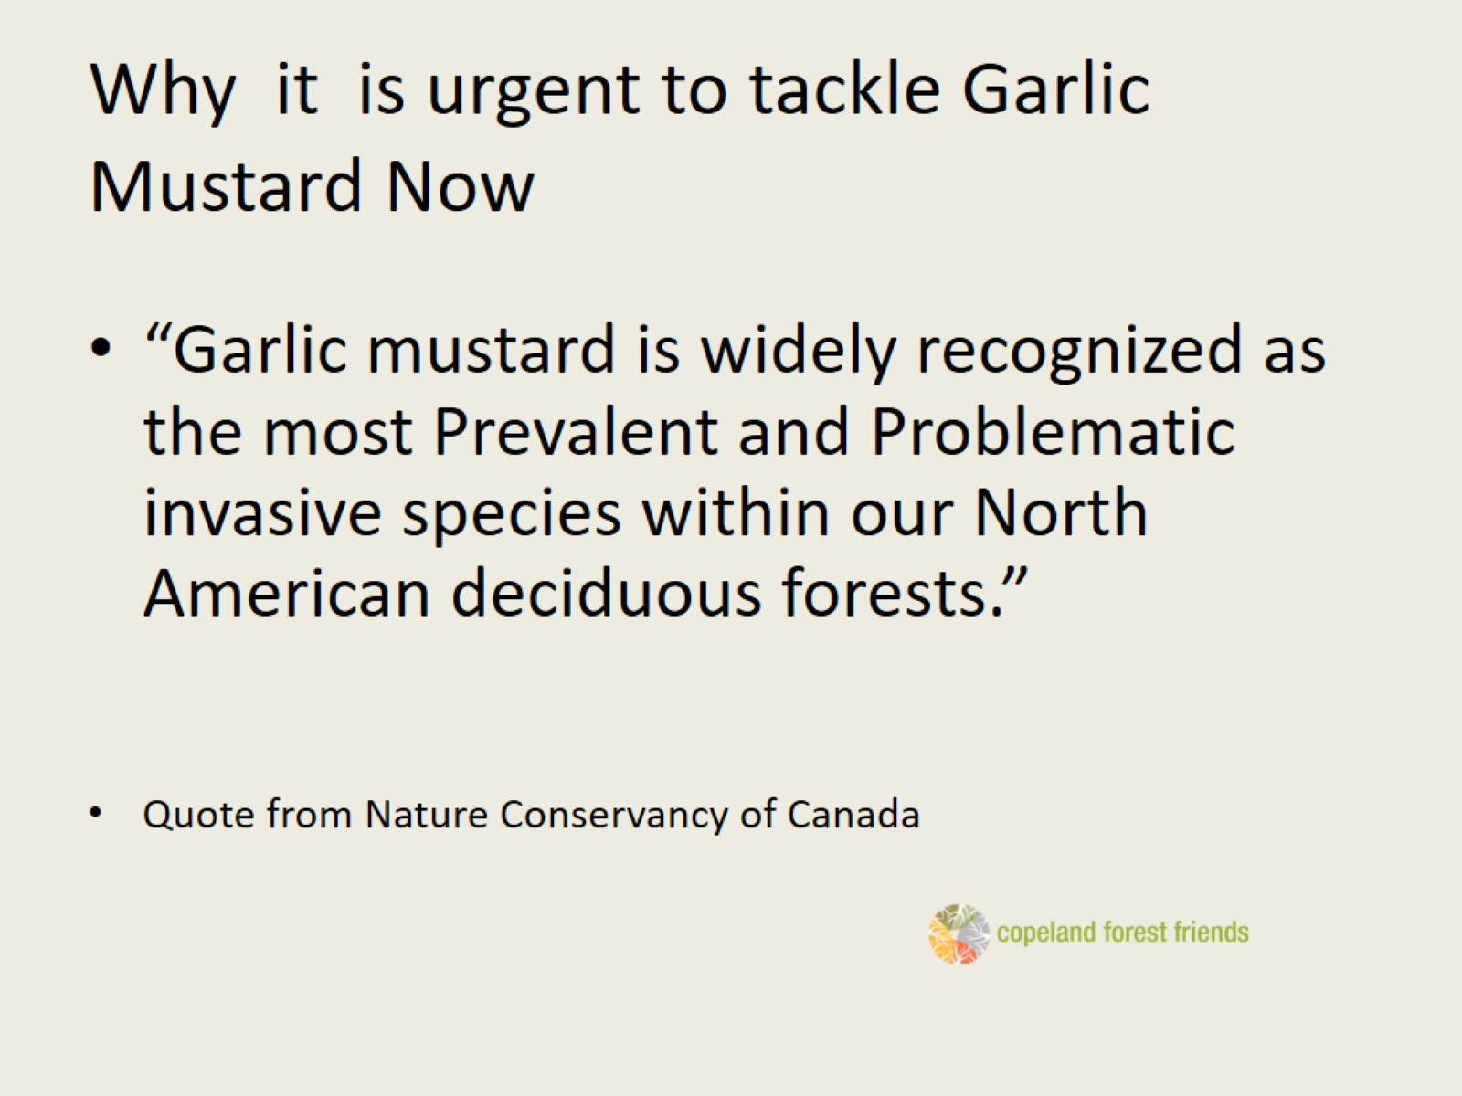
Why it is urgent to tackle Garlic Mustard Now

Slide 4
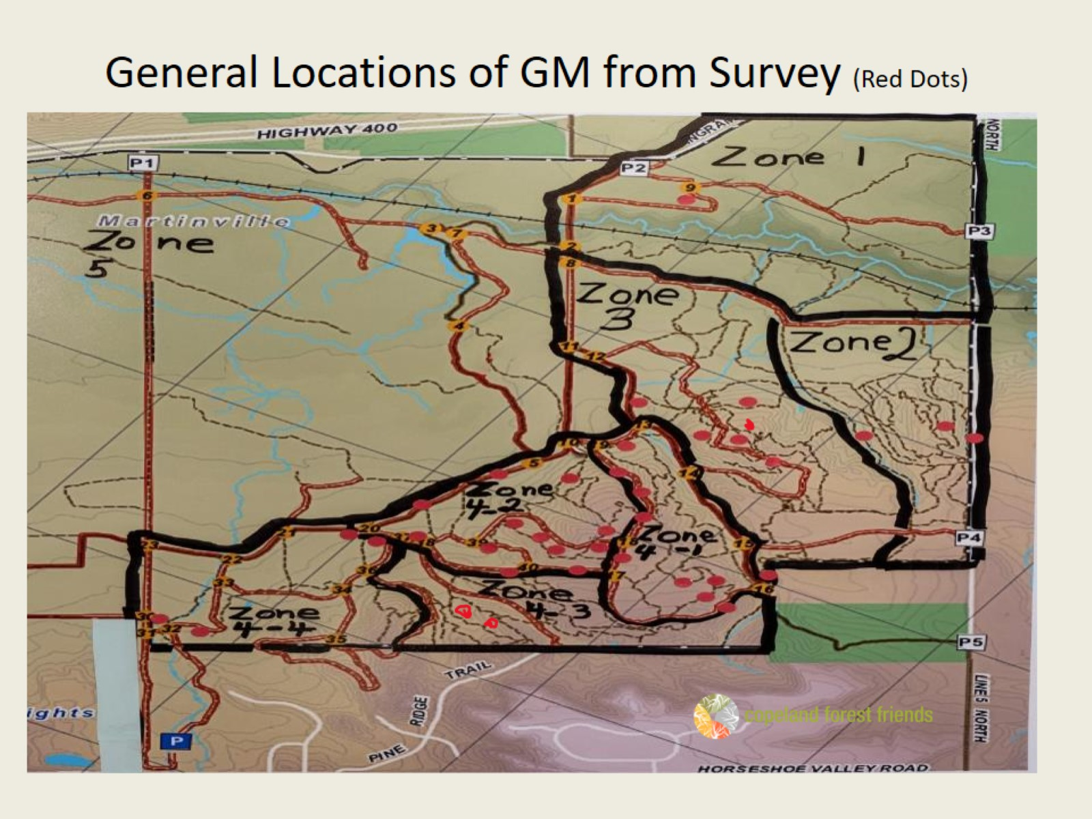
General Locations of GM from Survey (Red Dots)

Slide 5
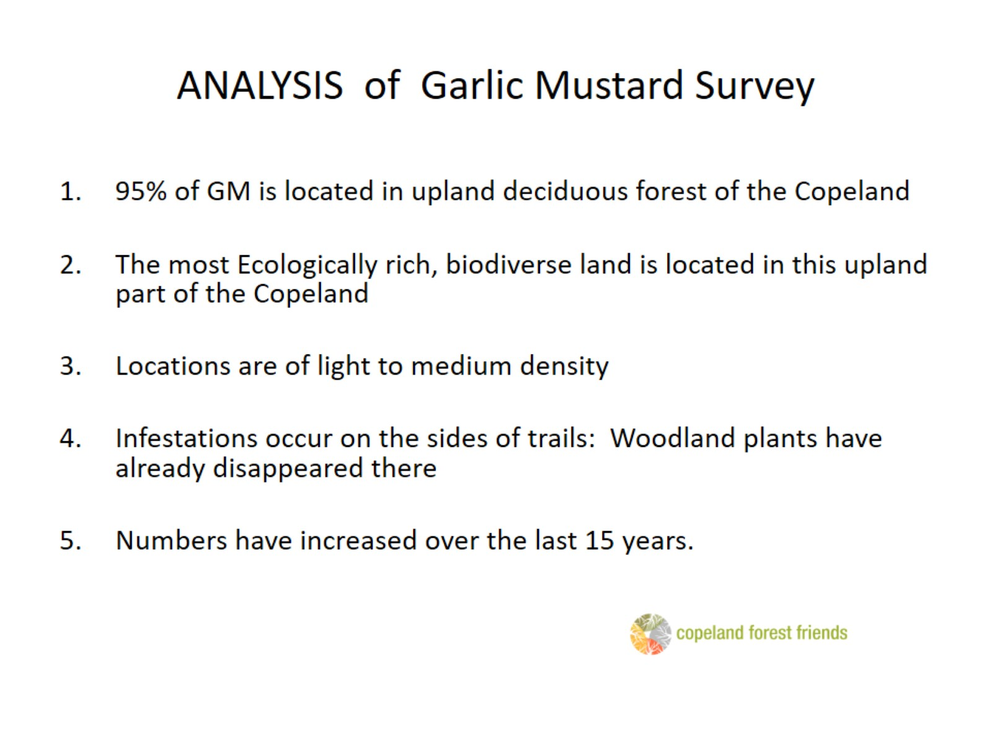
ANALYSIS of Garlic Mustard Survey

Slide 6
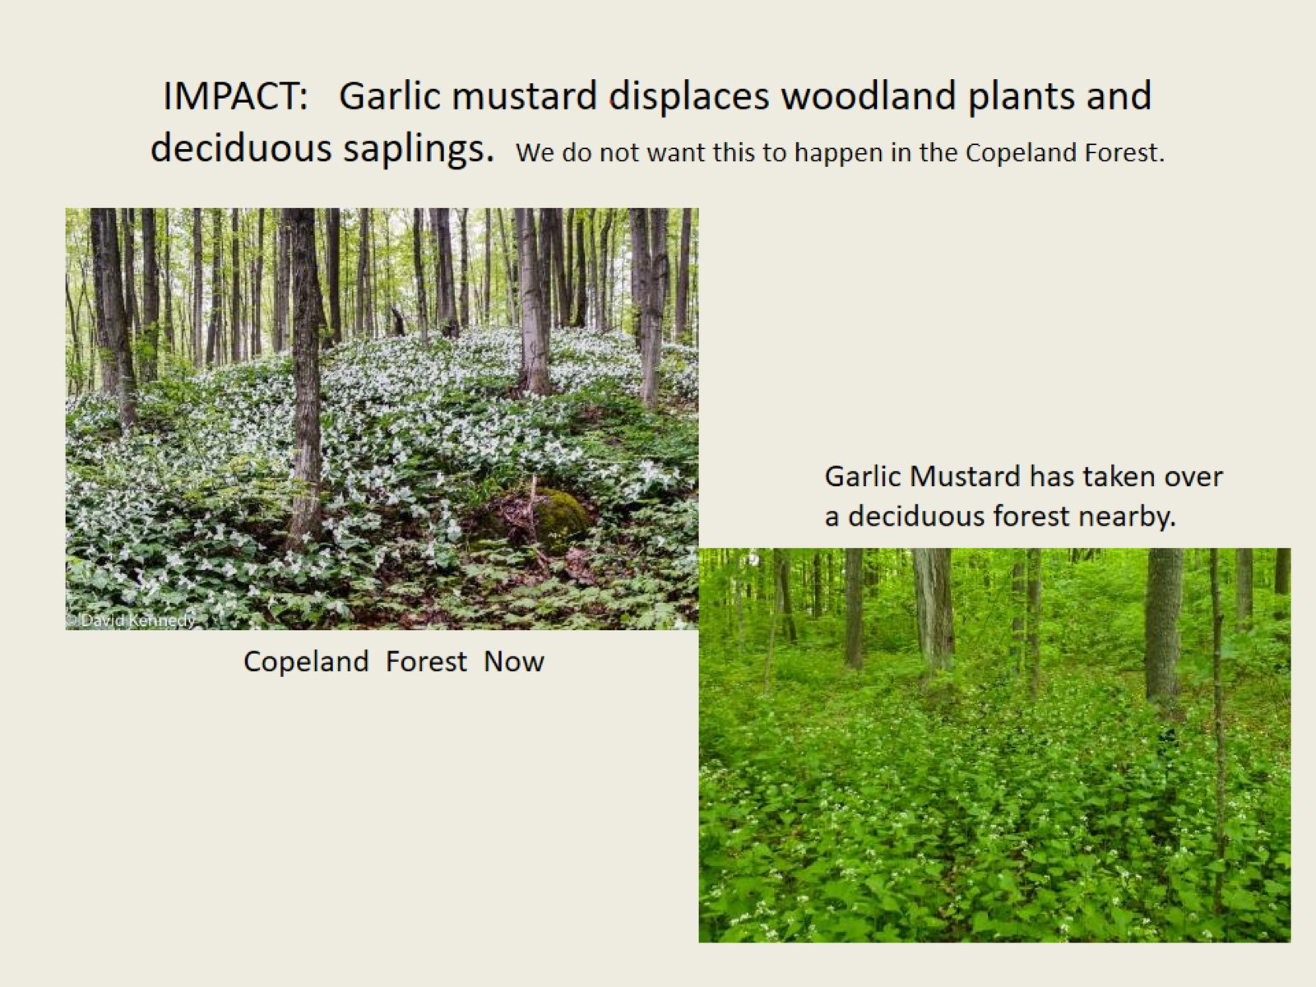
IMPACT: Garlic mustard displaces woodland plants and deciduous saplings. We do not want this to happen in the Copeland Forest.

Slide 7
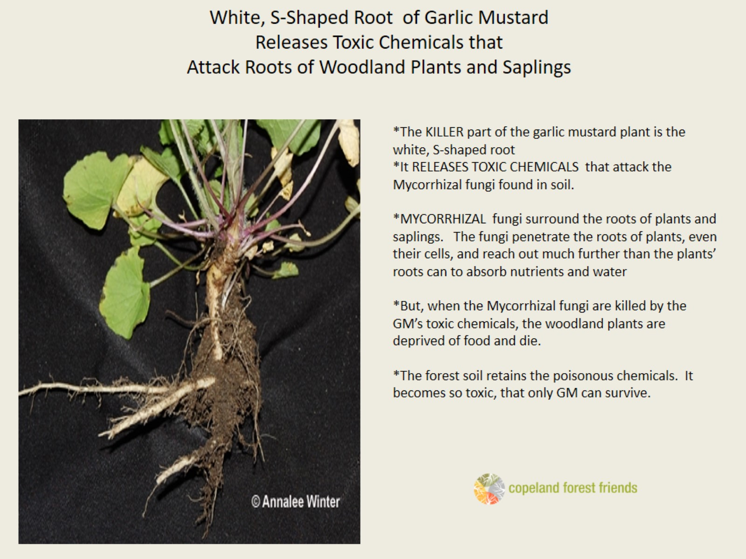
White, S-Shaped Root of Garlic Mustard Releases Toxic Chemicals that Attack Roots of Woodland Plants and Saplings

Slide 8
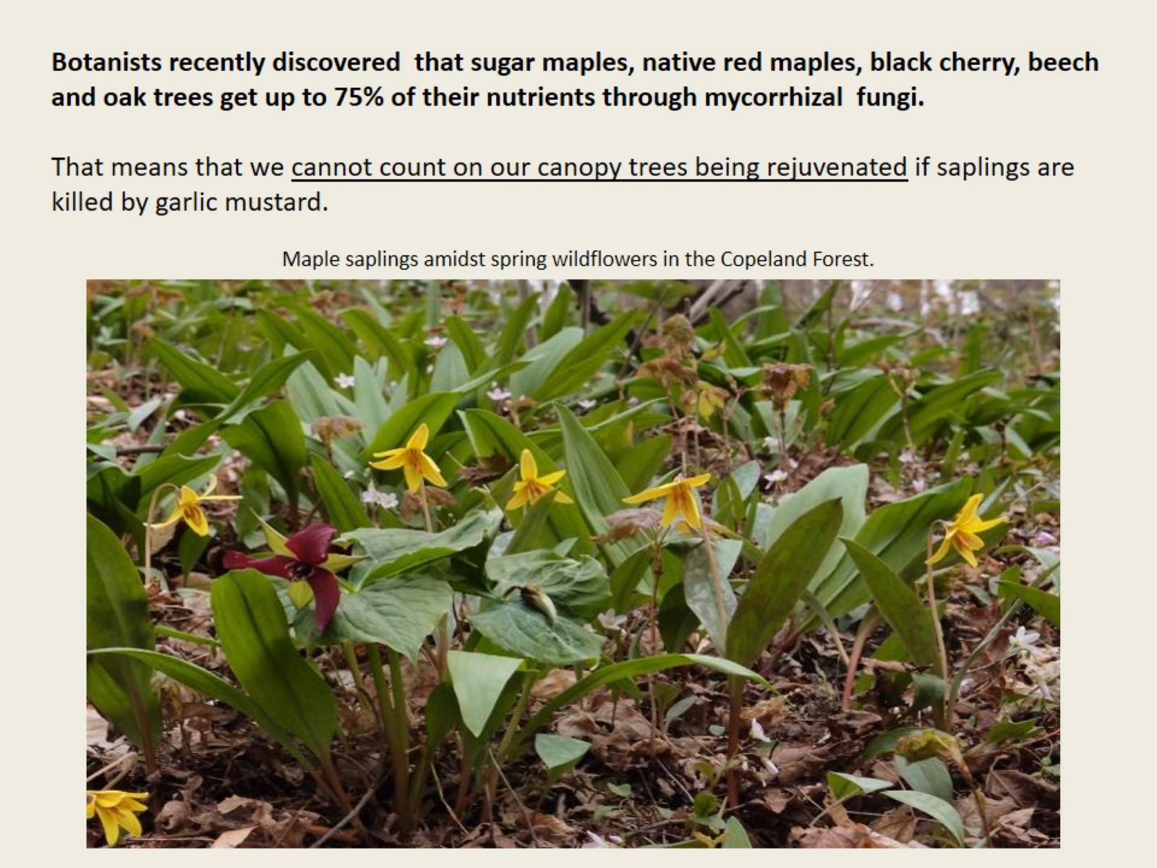
Woody plants get >75% nutrients from mycorrhizol fungi

Slide 9
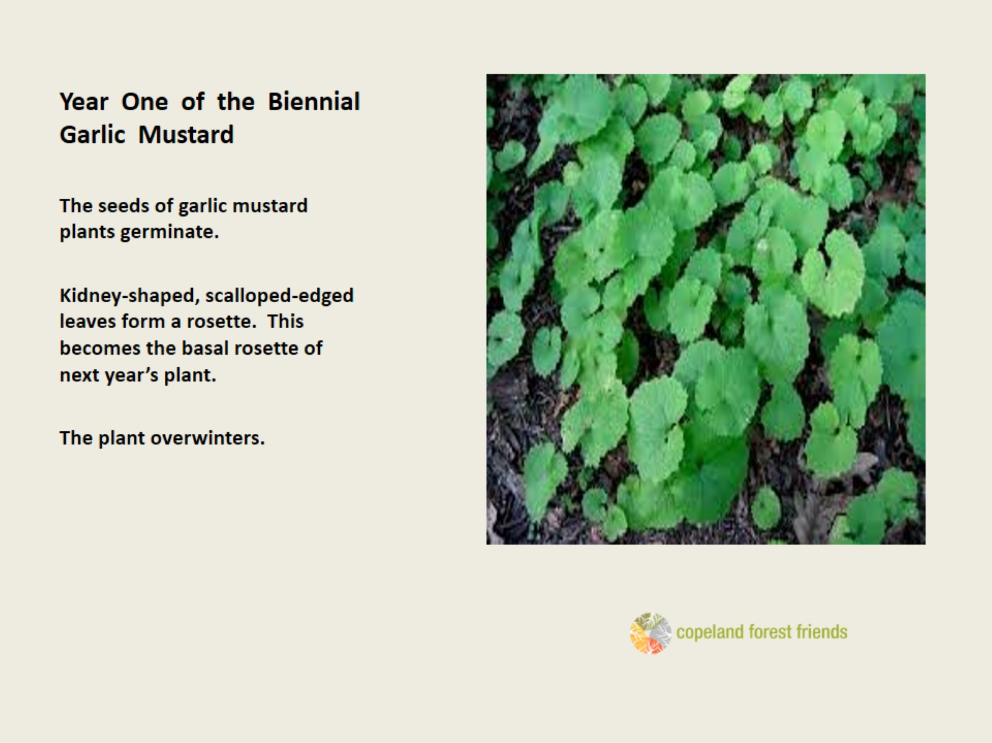
Year One of the Biennial Garlic Mustard

Slide 10
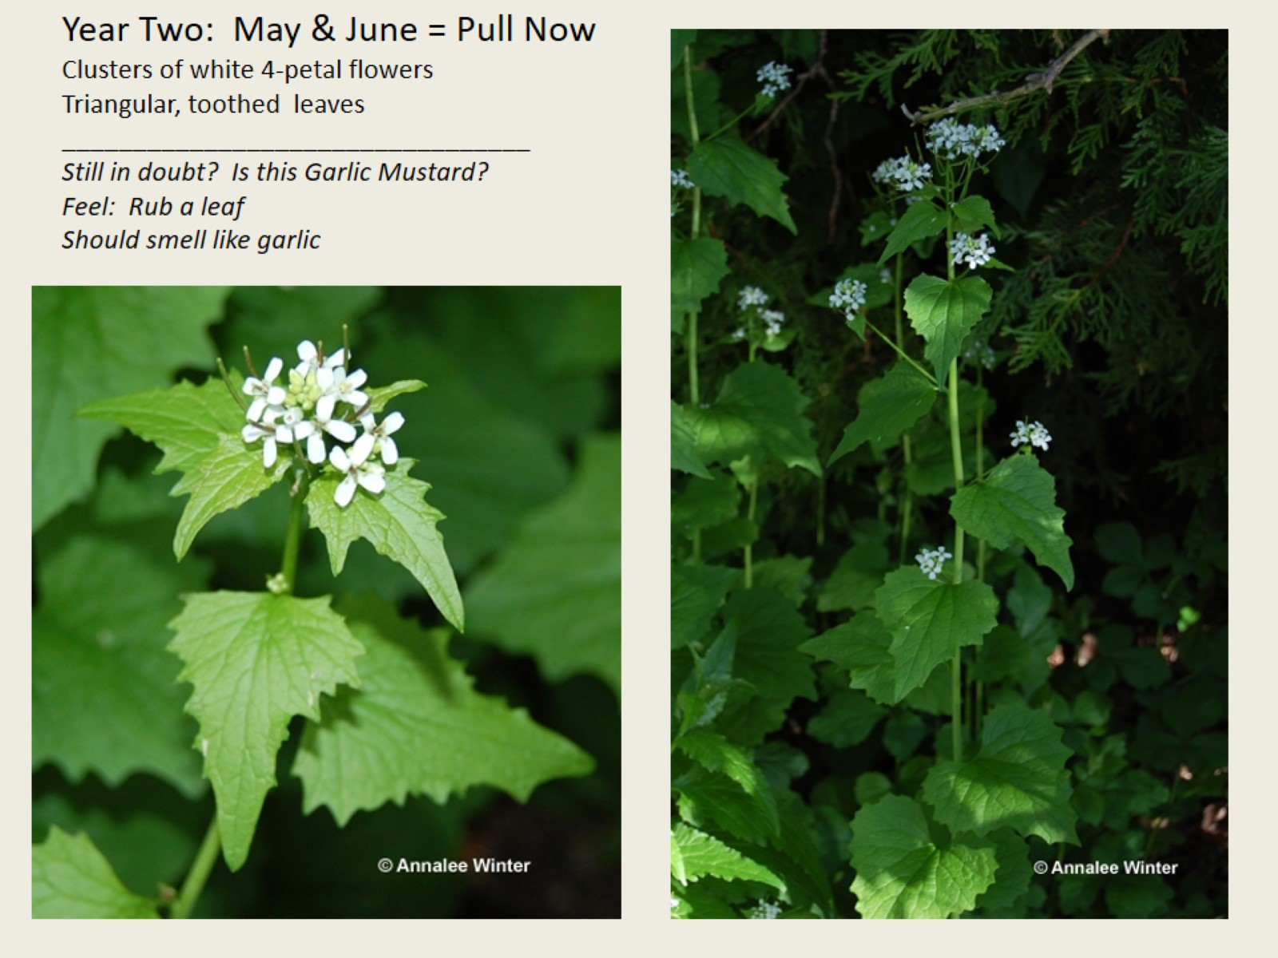
Year Two: May & June = Pull Now Clusters of white 4-petal flowers Triangular, toothed leaves _________________________________ Still in doubt? Is this Garlic Mustard? Feel: Rub a leaf Should smell like garlic

Slide 11
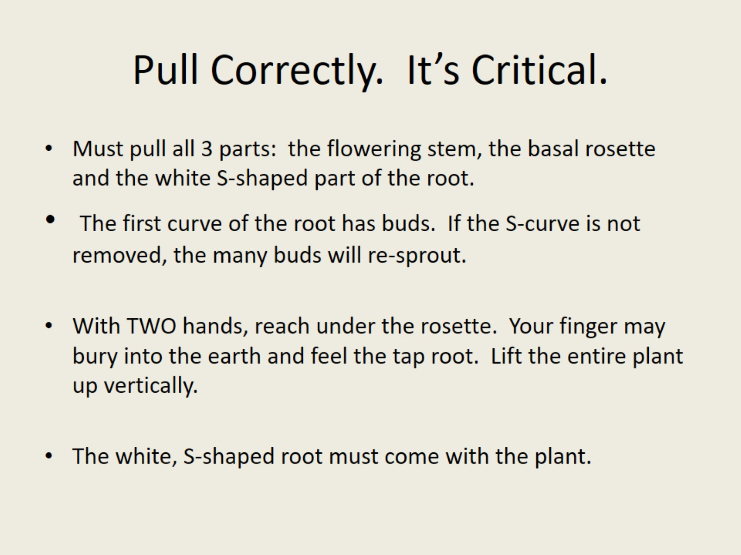
Pull Correctly. It’s Critical.

Slide 12
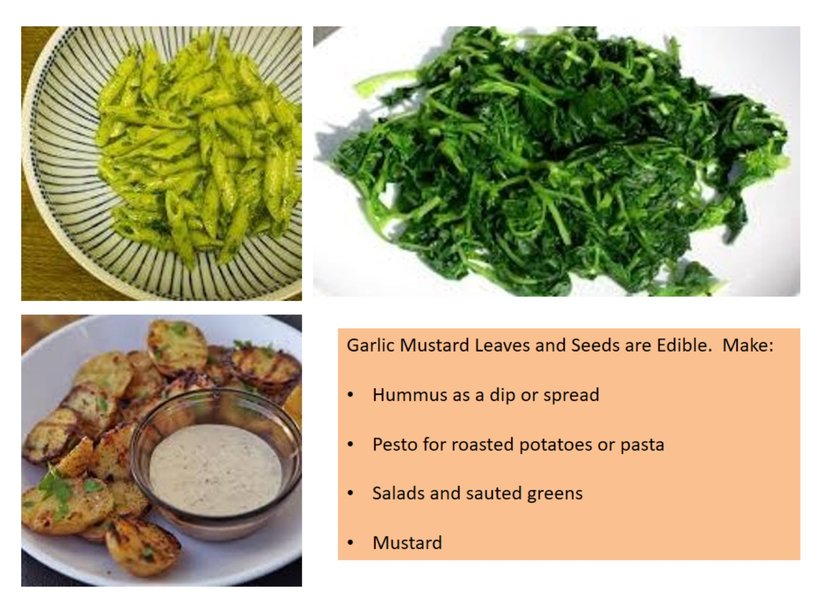
Aioli, G Yummy!

Slide 13
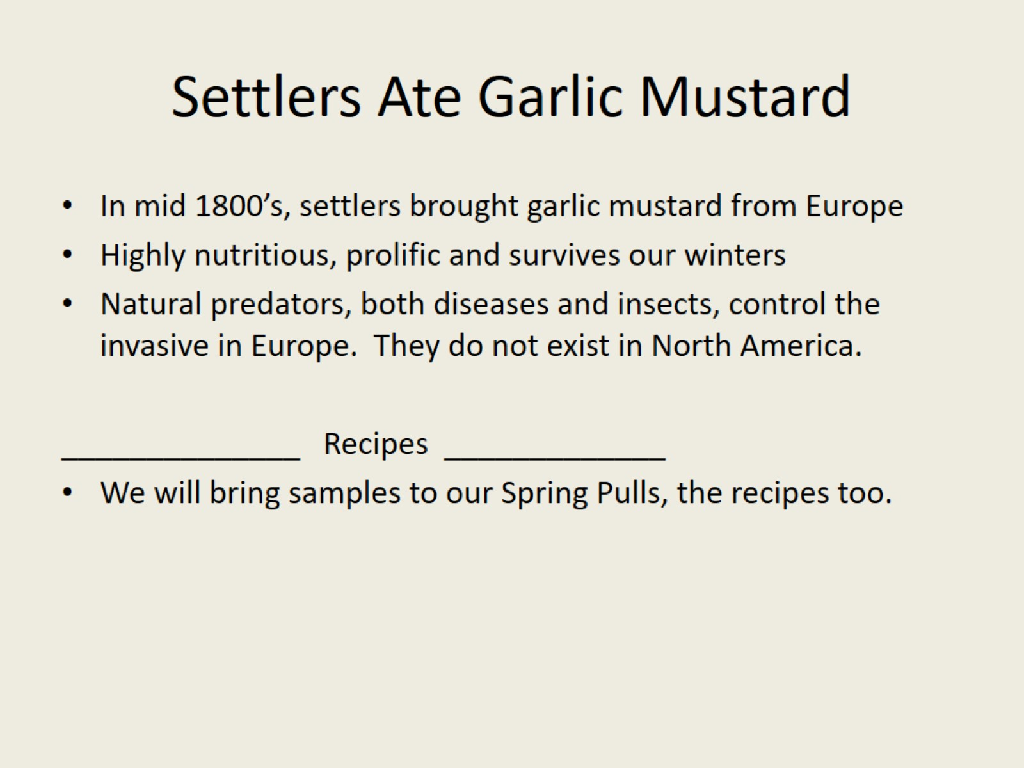
Settlers Ate Garlic Mustard

Slide 14
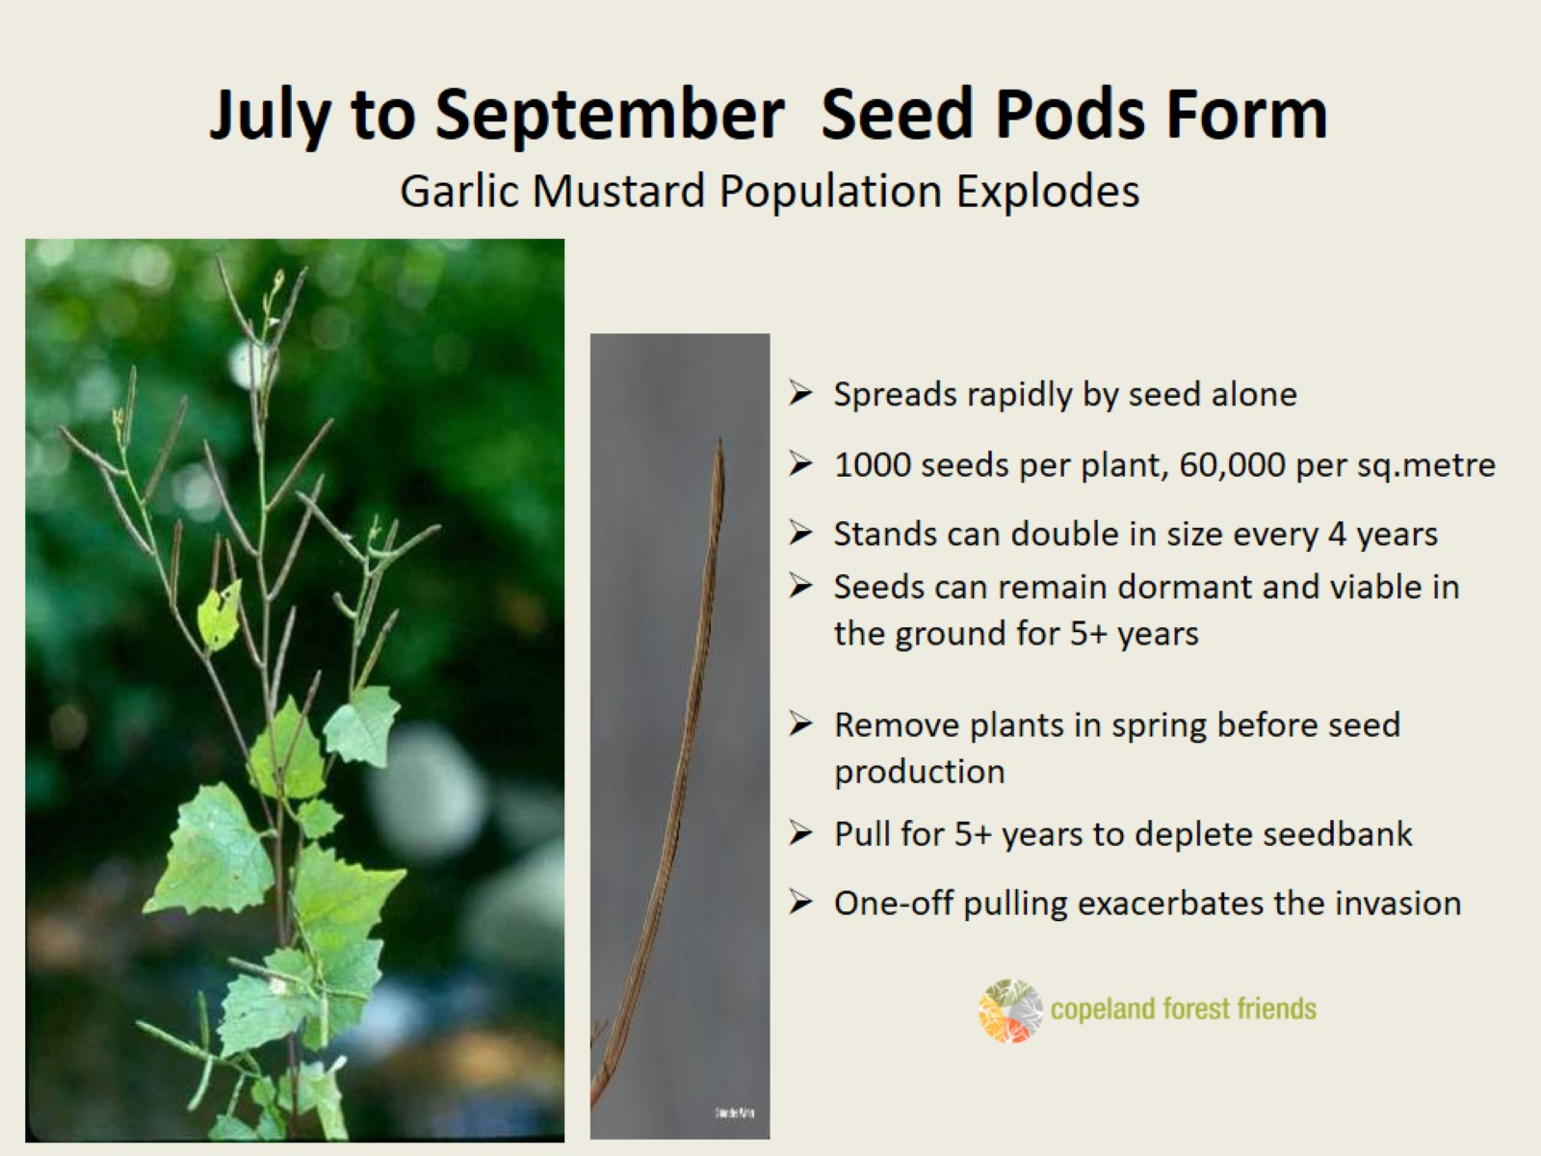
July to September Seed Pods Form Garlic Mustard Population Explodes

Slide 15
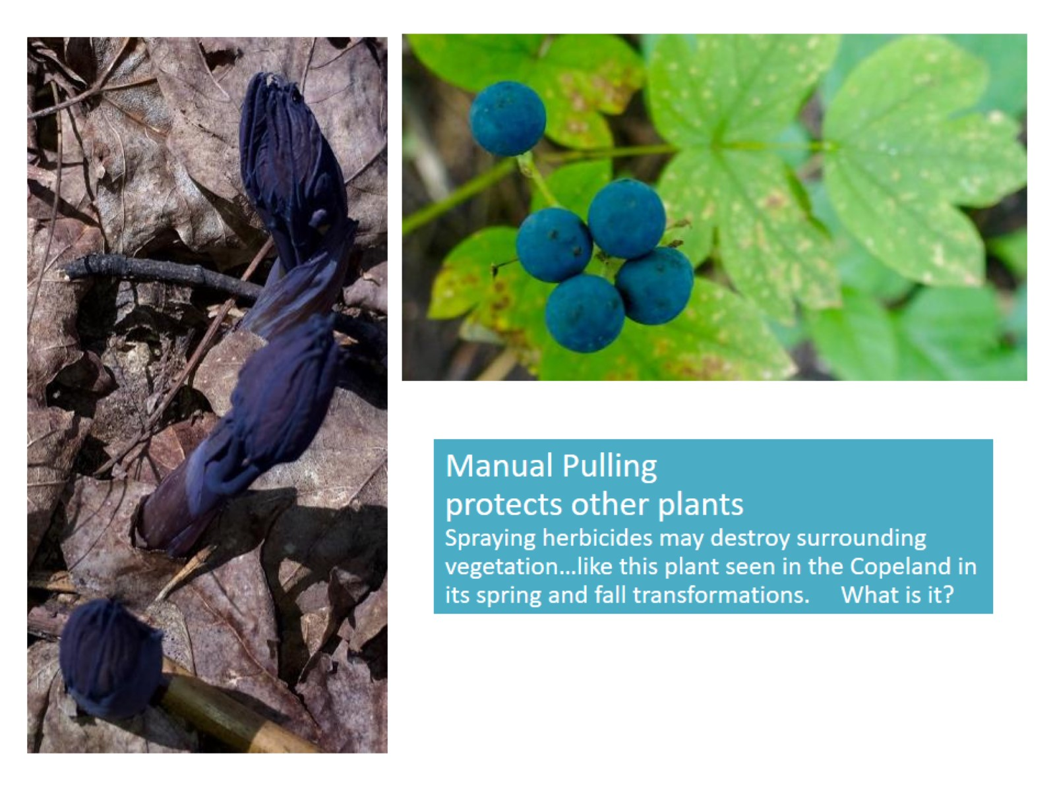
Manual Pulling protects other plants Spraying herbicides may destroy surrounding vegetation…like this plant seen in the Copeland in its spring and fall transformations. What is it?

Slide 16
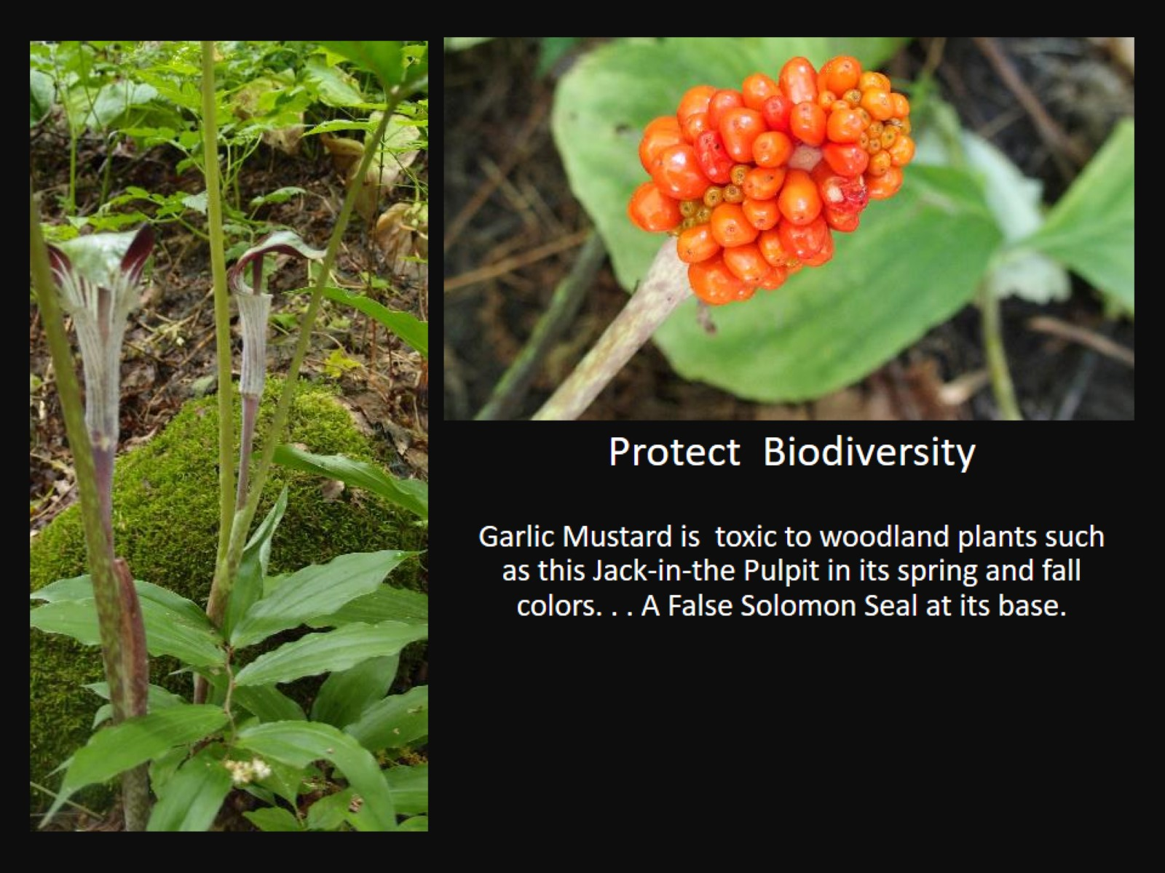
Protect Biodiversity Garlic Mustard is toxic to woodland plants such as this Jack-in-the Pulpit in its spring and fall colors. . . A False Solomon Seal at its base.

Slide 17
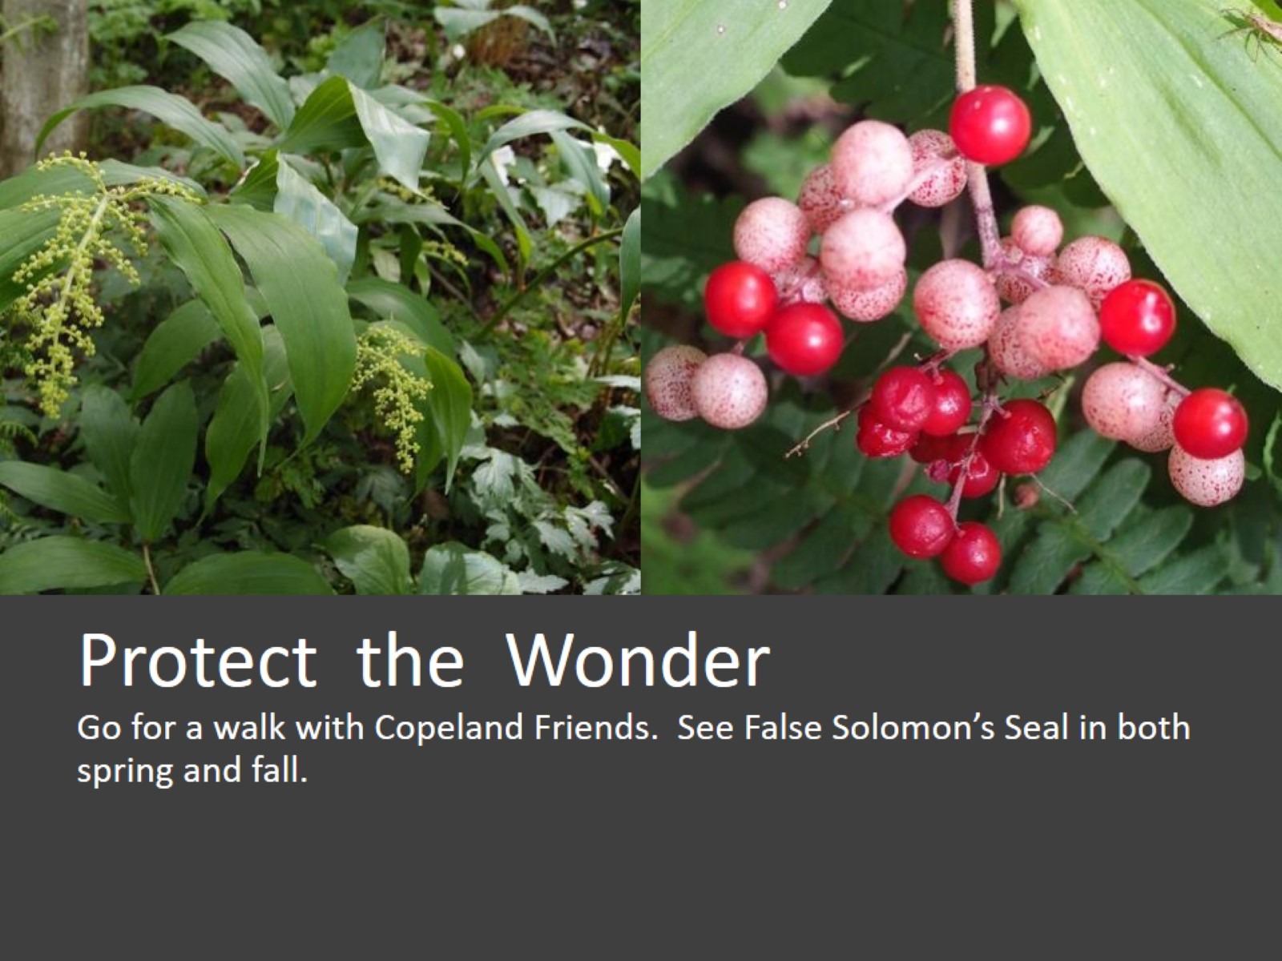
Protect the Wonder Go for a walk with Copeland Friends. See False Solomon’s Seal in both spring and fall.

Slide 18
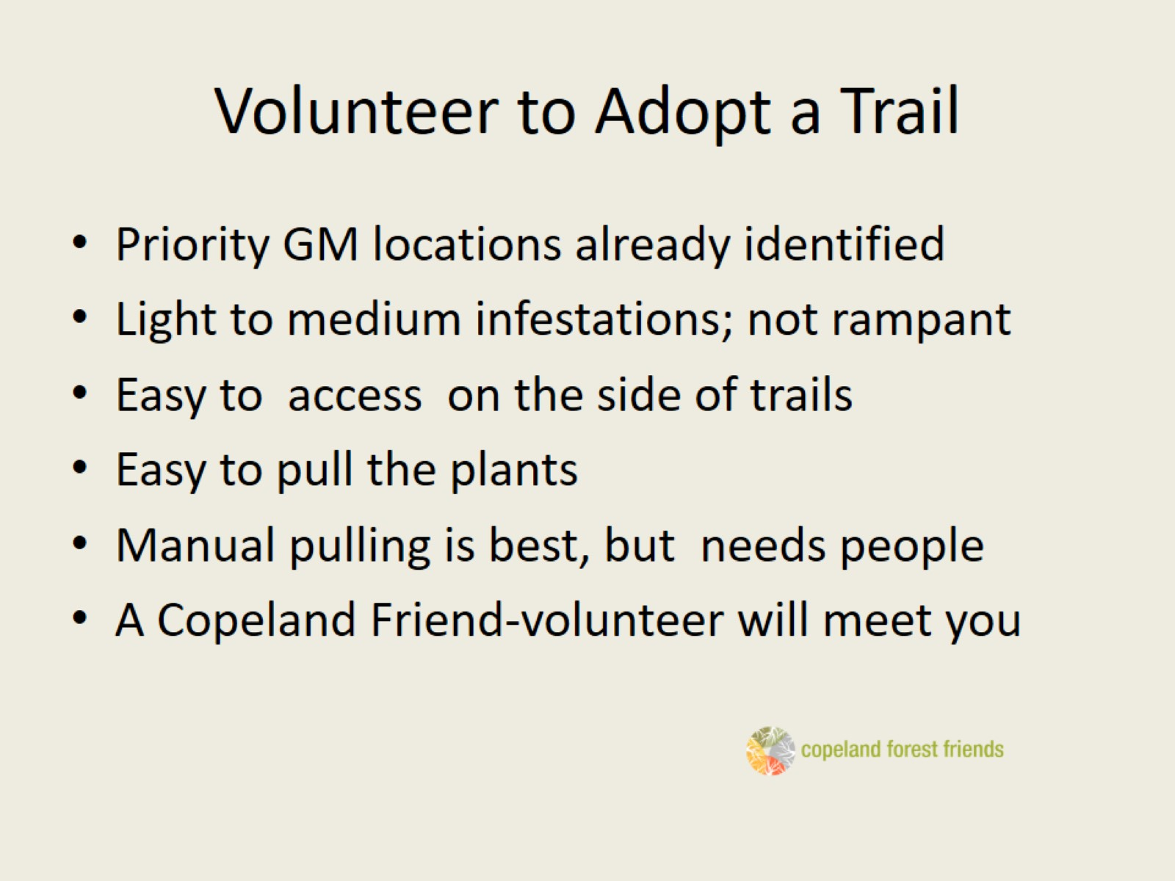
Volunteer to Adopt a Trail

Slide 19
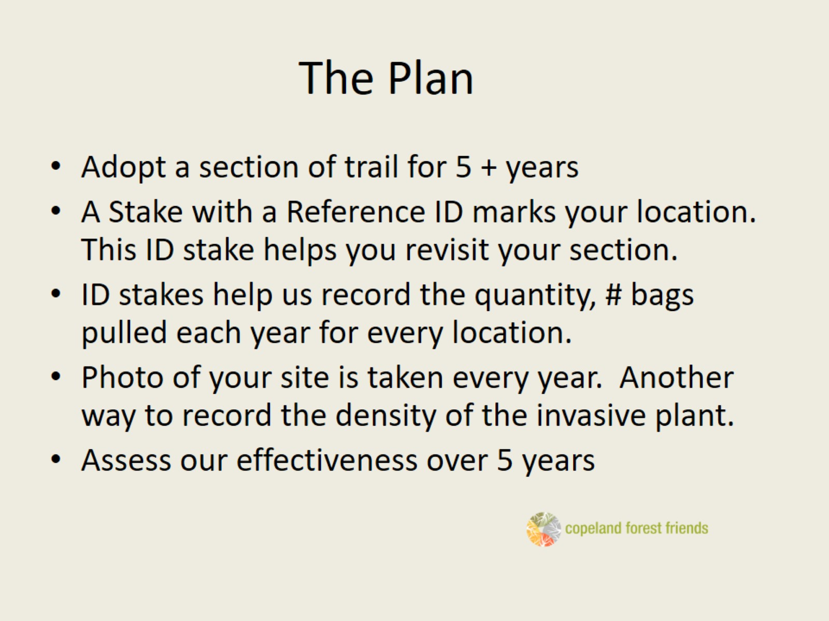
The Plan

Slide 20
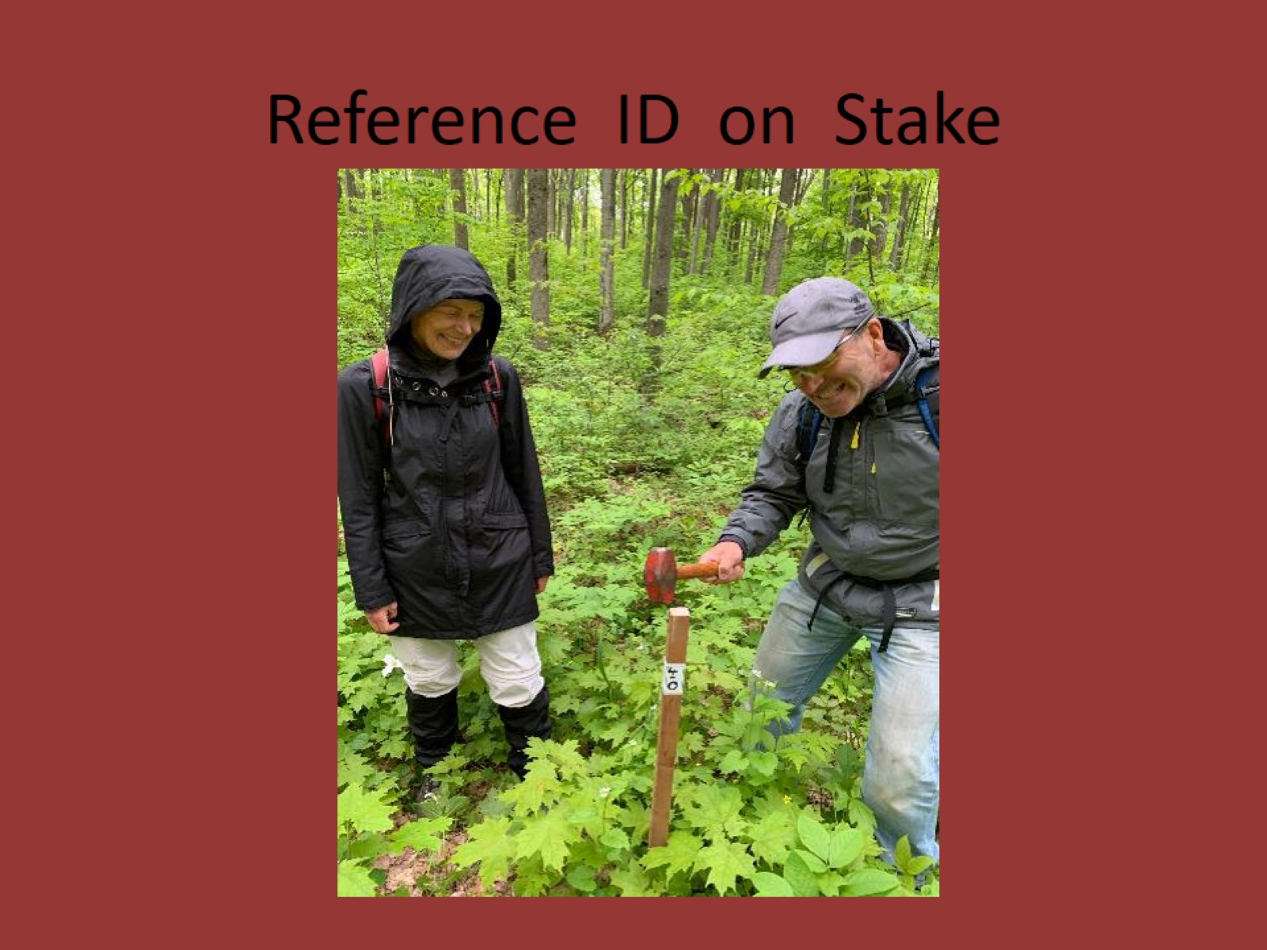
Reference ID on Stake

Slide 21
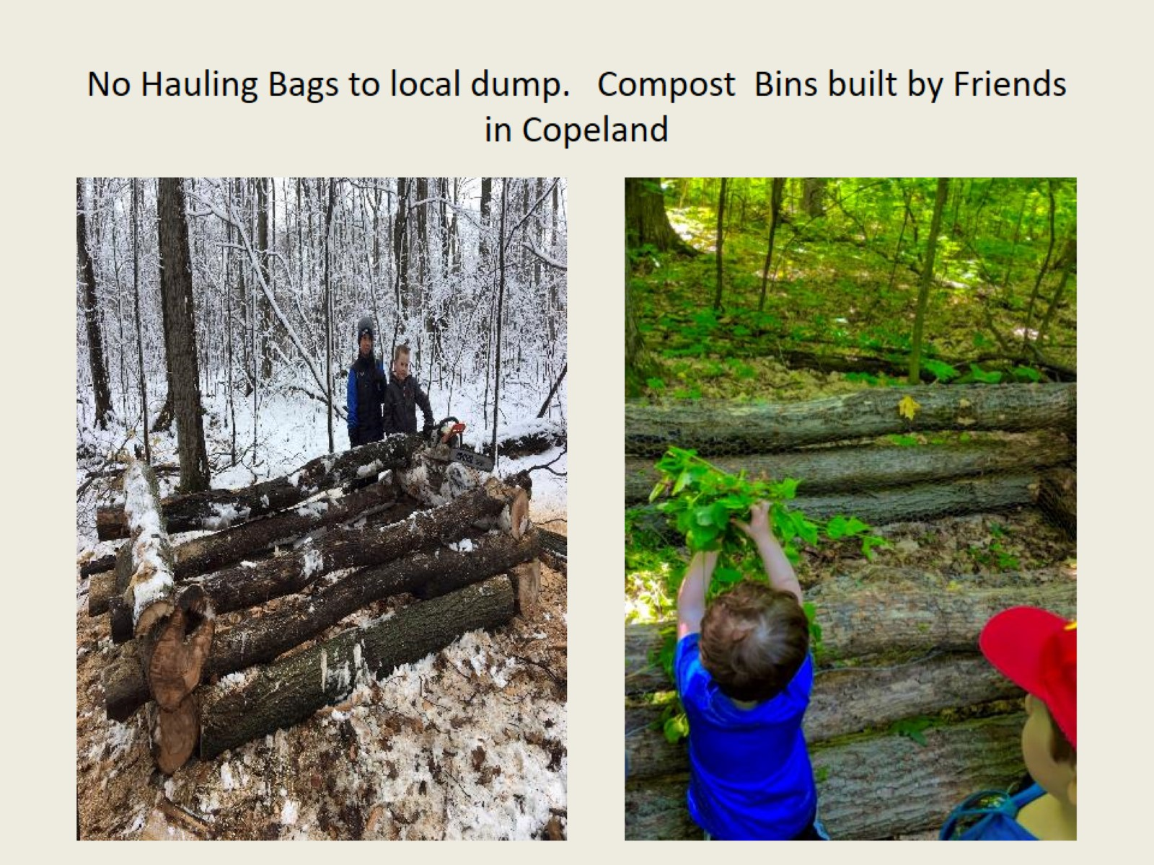
No Hauling Bags to local dump. Compost Bins built by Friends in Copeland

Slide 22
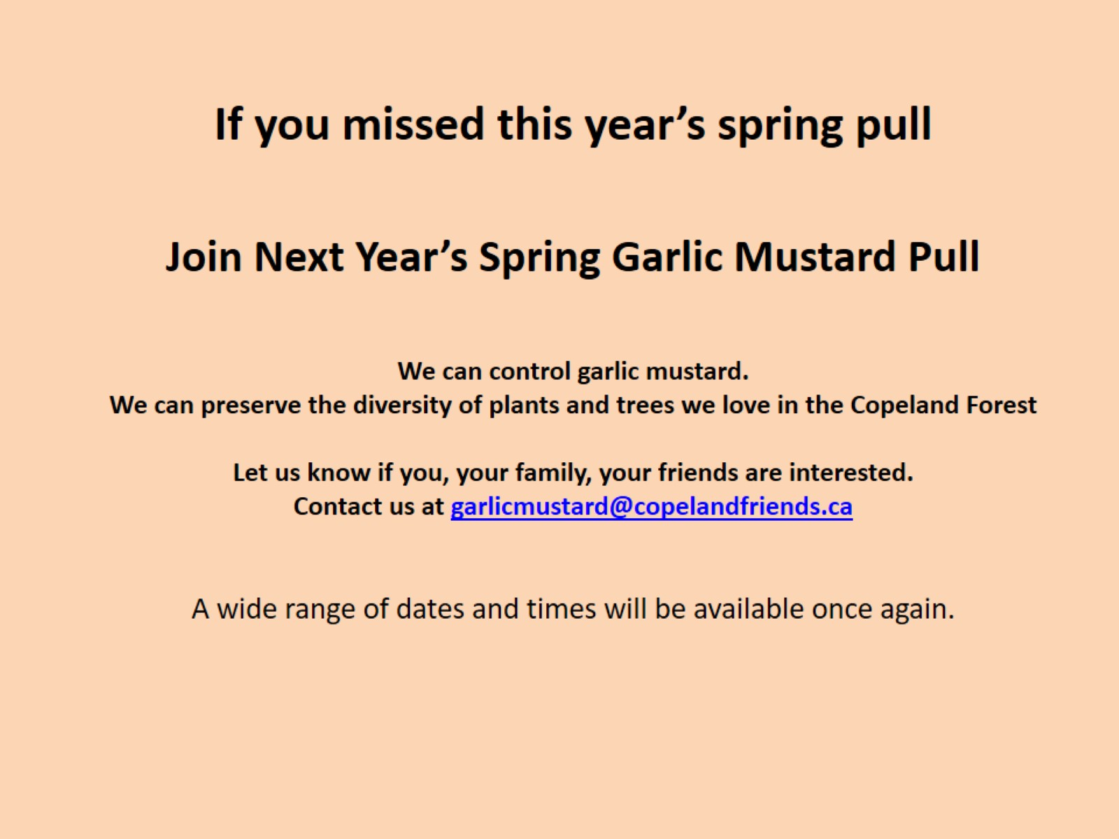
If you missed this year’s spring pull Join Next Year’s Spring Garlic Mustard Pull We can control garlic mustard. We can preserve the diversity of plants and trees we love in the Copeland Forest Let us know if you, your family, your friends are interested. Contact us at garlicmustard@copelandfriends.ca A wide range of dates and times will be available once again.

Slide 23
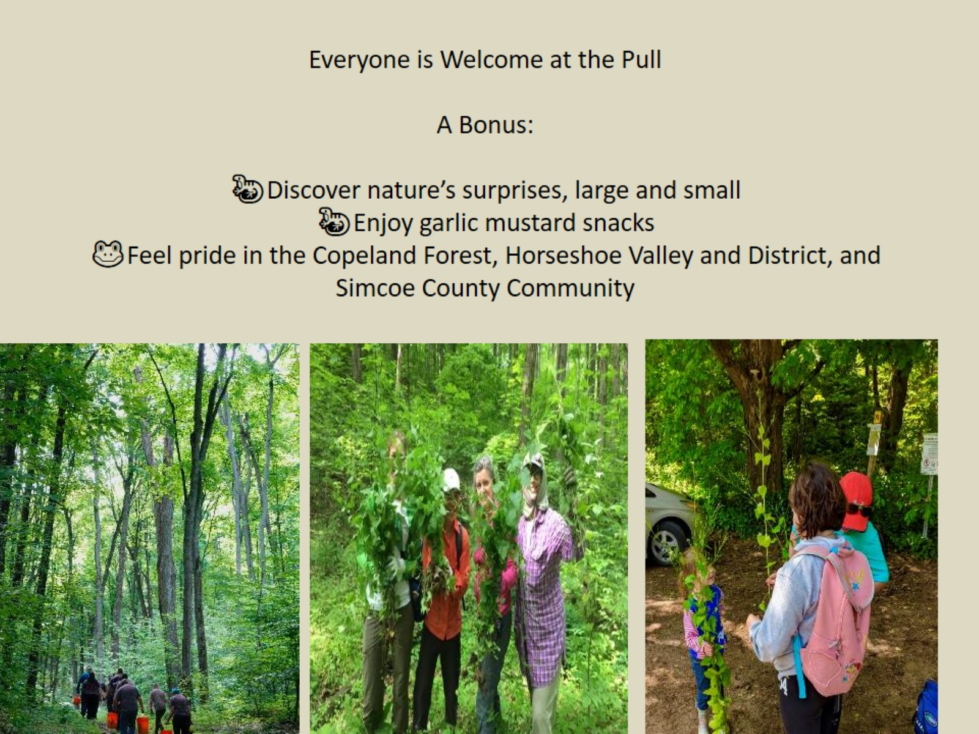
Everyone is Welcome at the Pull A Bonus: 🦎Discover nature’s surprises, large and small 🦎Enjoy garlic mustard snacks 🐸Feel pride in the Copeland Forest, Horseshoe Valley and District, and Simcoe County Community

Slide 24
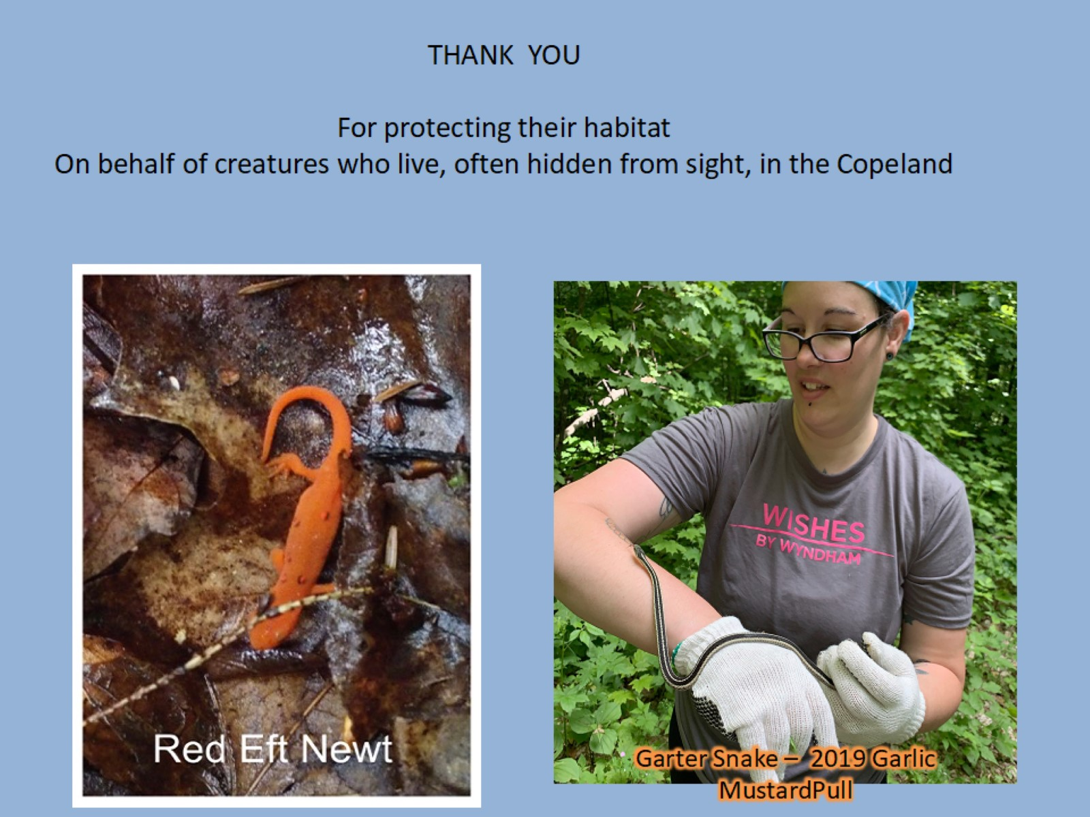
THANK YOU For protecting their habitat On behalf of creatures who live, often hidden from sight, in the Copeland

Slide 25
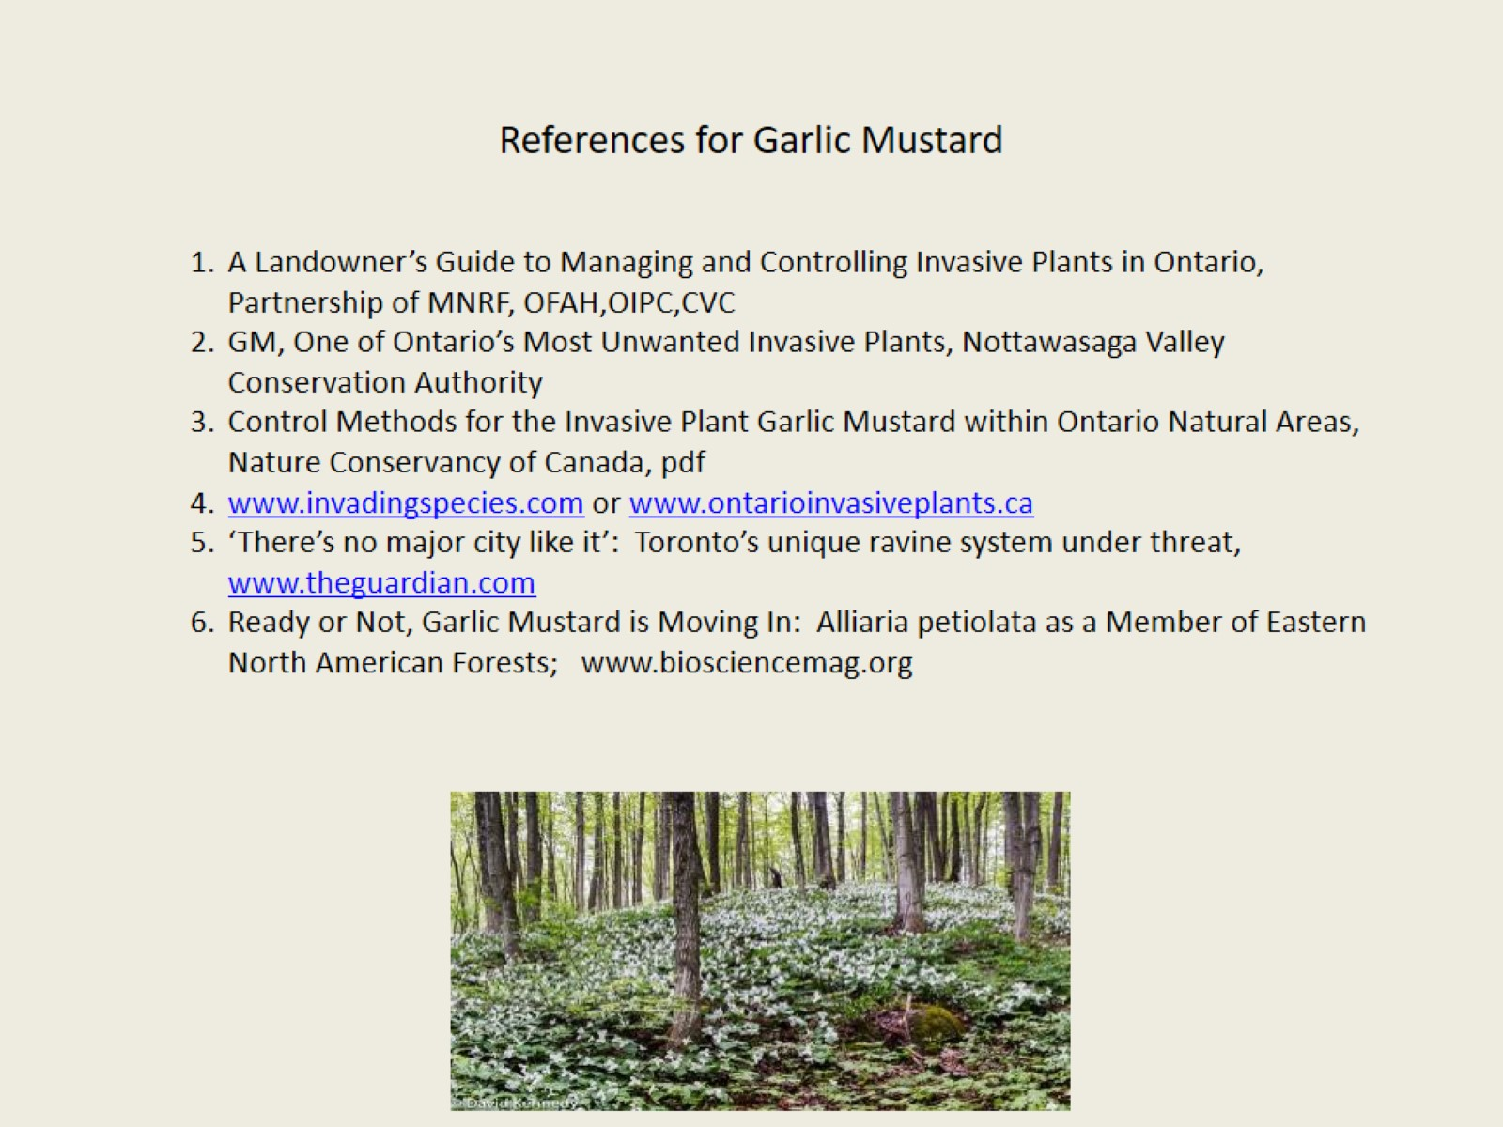
References for Garlic Mustard

