Slide 1
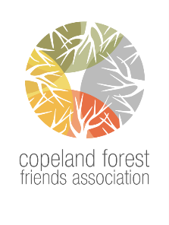
GARLIC MUSTARD PROJECT
Copeland Friend volunteers surveyed the Forest and marked the locations of garlic mustard.
Let’s Start Pulling

Slide 2
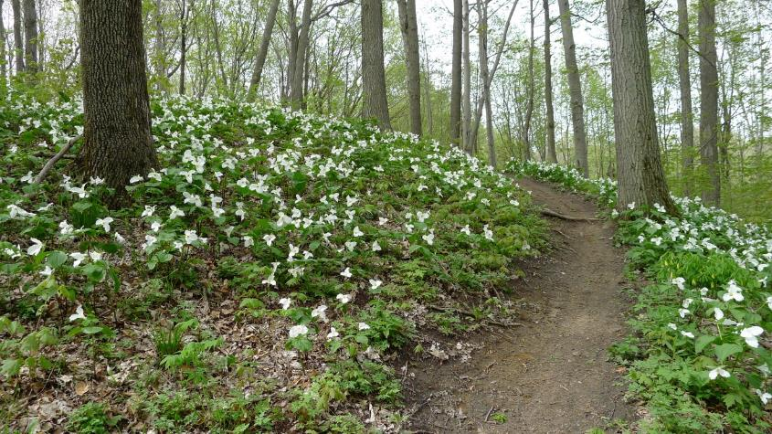
Under Threat

Slide 3

Why it is urgent to tackle Garlic Mustard Now
“Garlic mustard is widely recognized as the most Prevalent and Problematic invasive species within our North American deciduous forests.”
Quote from Nature Conservancy of Canada

Slide 4
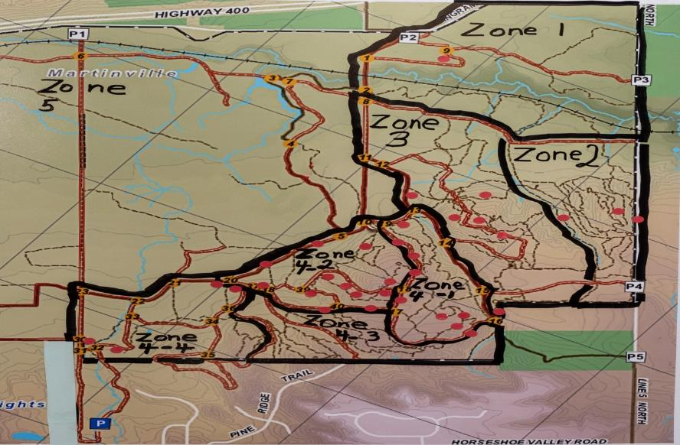
General Locations of GM from Survey (Red Dots)

Slide 5
ANALYSIS of Garlic Mustard Survey
95% of GM is located in upland deciduous forest of the Copeland
The most Ecologically rich, biodiverse land is located in this upland part of the Copeland
Locations are of light to medium density
Infestations occur on the sides of trails: Woodland plants have already disappeared there
Numbers have increased over the last 15 years.

Slide 6
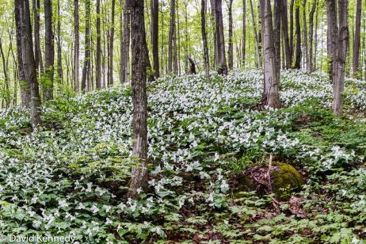
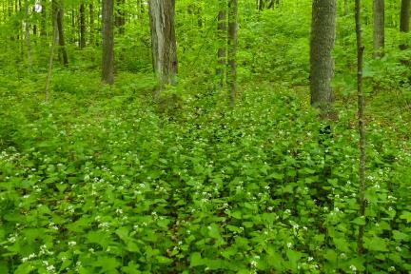
IMPACT: Garlic mustard displaces woodland plants and deciduous saplings. We do not want this to happen in the Copeland Forest.
Garlic Mustard has taken over a deciduous forest nearby.
Copeland Forest Now

Slide 7
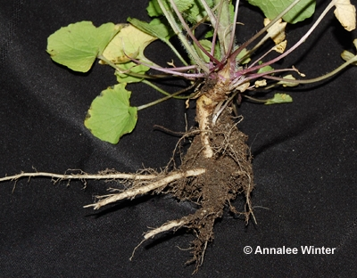
White, S-Shaped Root of Garlic Mustard Releases Toxic Chemicals that Attack Roots of Woodland Plants and Saplings
*The KILLER part of the garlic mustard plant is the white, S-shaped root
*It RELEASES TOXIC CHEMICALS that attack the Mycorrhizal fungi found in soil.
*MYCORRHIZAL fungi surround the roots of plants and saplings. The fungi penetrate the roots of plants, even their cells, and reach out much further than the plants’ roots can to absorb nutrients and water
*But, when the Mycorrhizal fungi are killed by the GM’s toxic chemicals, the woodland plants are deprived of food and die.
*The forest soil retains the poisonous chemicals. It becomes so toxic, that only GM can survive.

Slide 8
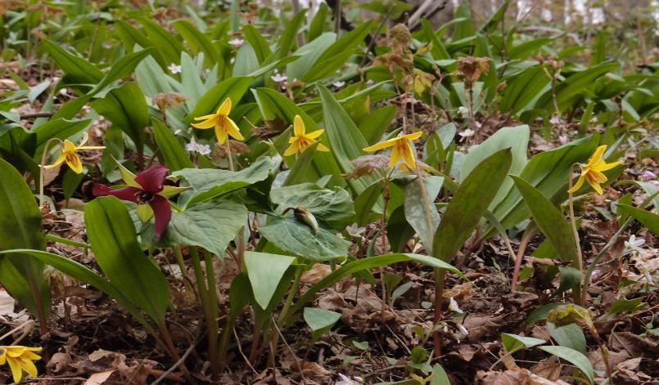
Woody plants get >75% nutrients from mycorrhizol fungi
Botanists recently discovered that sugar maples, native red maples, black cherry, beech and oak trees get up to 75% of their nutrients through mycorrhizal fungi.
That means that we cannot count on our canopy trees being rejuvenated if saplings are killed by garlic mustard.
Maple saplings amidst spring wildflowers in the Copeland Forest.

Slide 9
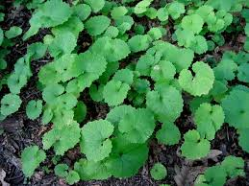
Year One of the Biennial Garlic Mustard
The seeds of garlic mustard plants germinate.
Kidney-shaped, scalloped-edged leaves form a rosette. This becomes the basal rosette of next year’s plant.
The plant overwinters.

Slide 10
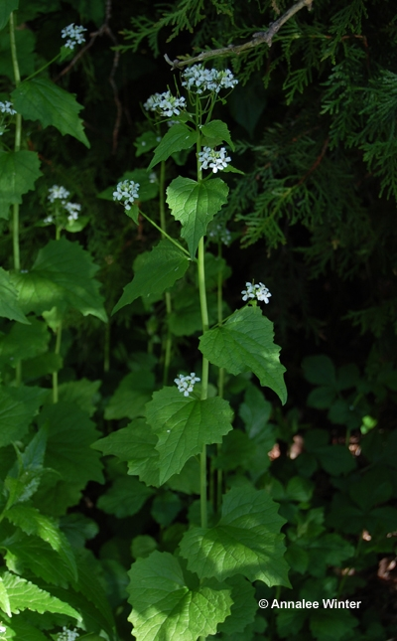
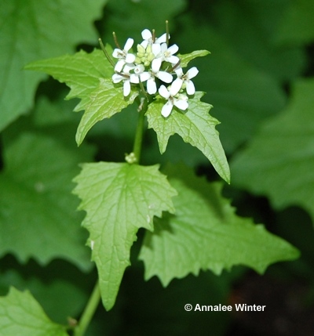
Year Two: May & June = Pull Now Clusters of white 4-petal flowers Triangular, toothed leaves _________________________________ Still in doubt? Is this Garlic Mustard? Feel: Rub a leaf Should smell like garlic

Slide 11
Pull Correctly. It’s Critical.
Must pull all 3 parts: the flowering stem, the basal rosette and the white S-shaped part of the root.
The first curve of the root has buds. If the S-curve is not removed, the many buds will re-sprout.
With TWO hands, reach under the rosette. Your finger may bury into the earth and feel the tap root. Lift the entire plant up vertically.
The white, S-shaped root must come with the plant.

Slide 12
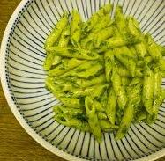
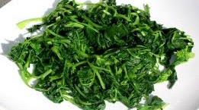
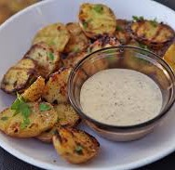
Aioli, G Yummy!
Garlic Mustard Leaves and Seeds are Edible. Make:
Hummus as a dip or spread
Pesto for roasted potatoes or pasta
Salads and sauted greens
Mustard

Slide 13
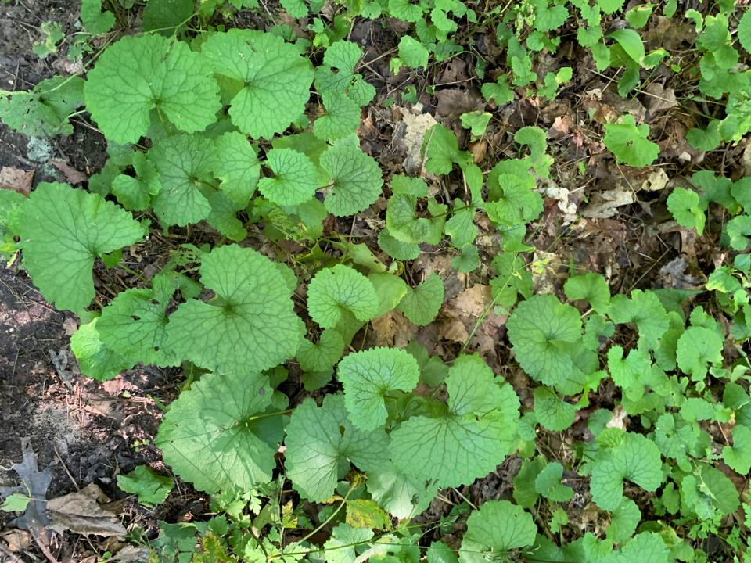
Settlers Ate Garlic Mustard
In mid 1800’s, settlers brought garlic mustard from Europe
Highly nutritious, prolific and survives our winters
Natural predators, both diseases and insects, control the invasive in Europe. They do not exist in North America.
______________ Recipes _____________
We will bring samples to our Spring Pulls, the recipes too.

Slide 14
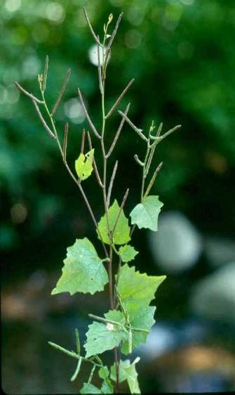
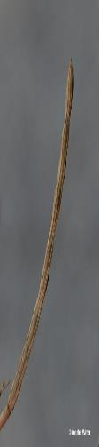
July to September Seed Pods Form Garlic Mustard Population Explodes
Spreads rapidly by seed alone
1000 seeds per plant, 60,000 per sq.metre
Stands can double in size every 4 years
Seeds can remain dormant and viable in the ground for 5+ years
Remove plants in spring before seed production
Pull for 5+ years to deplete seedbank
One-off pulling exacerbates the invasion

Slide 15
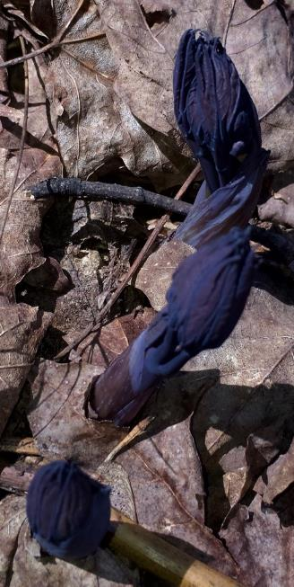
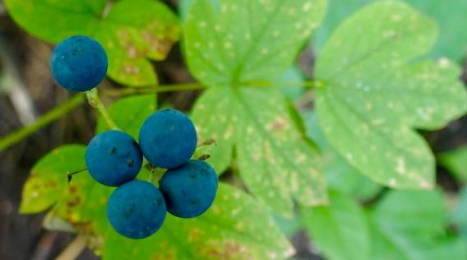
Manual Pulling protects other plants Spraying herbicides may destroy surrounding vegetation…like this plant seen in the Copeland in its spring and fall transformations. What is it?

Slide 16
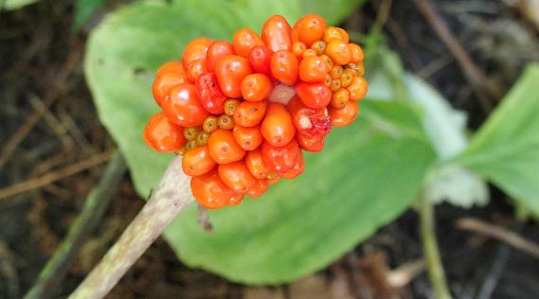
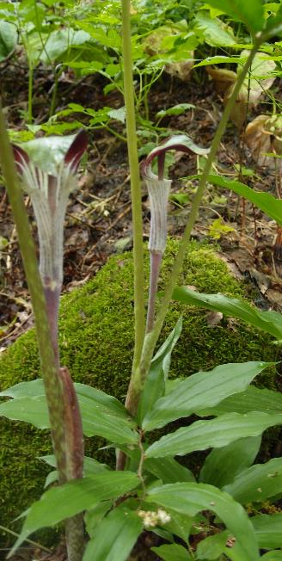
Protect Biodiversity Garlic Mustard is toxic to woodland plants such as this Jack-in-the Pulpit in its spring and fall colors. . . A False Solomon Seal at its base.

Slide 17
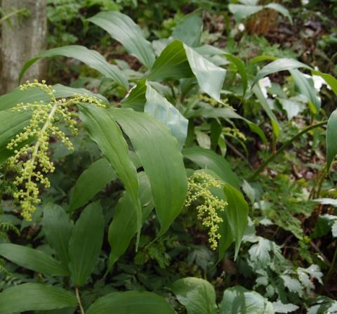
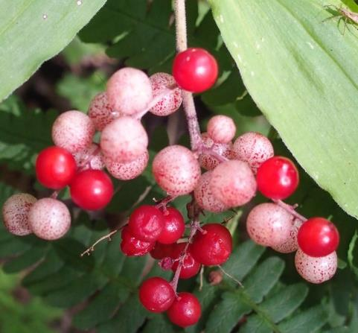
Protect the Wonder Go for a walk with Copeland Friends. See False Solomon’s Seal in both spring and fall.

Slide 18
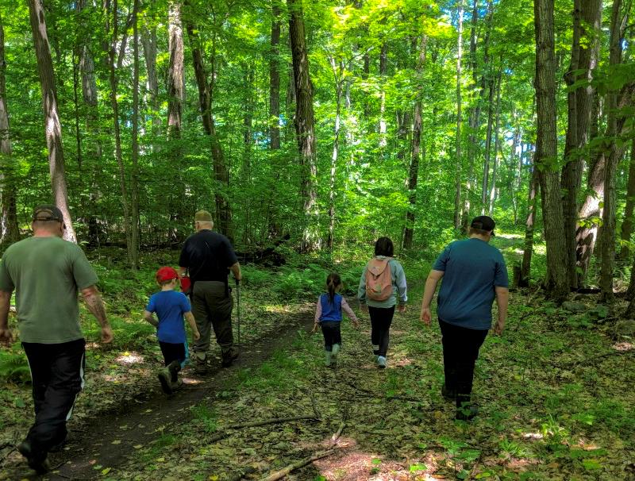
Volunteer to Adopt a Trail
Priority GM locations already identified
Light to medium infestations; not rampant
Easy to access on the side of trails
Easy to pull the plants
Manual pulling is best, but needs people
A Copeland Friend-volunteer will meet you

Slide 19
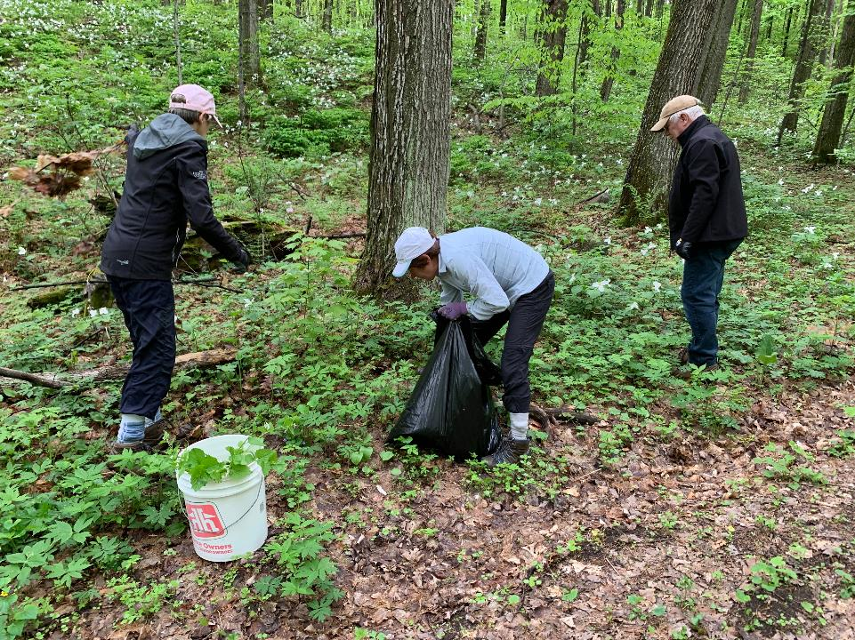
The Plan
Adopt a section of trail for 5 + years
A Stake with a Reference ID marks your location. This ID stake helps you revisit your section.
ID stakes help us record the quantity, # bags pulled each year for every location.
Photo of your site is taken every year. Another way to record the density of the invasive plant.
Assess our effectiveness over 5 years

Slide 20
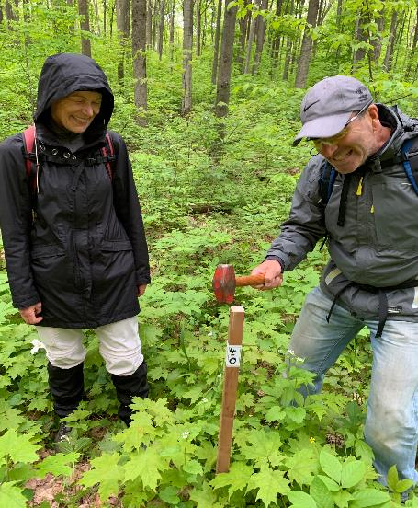
Reference ID on Stake

Slide 21
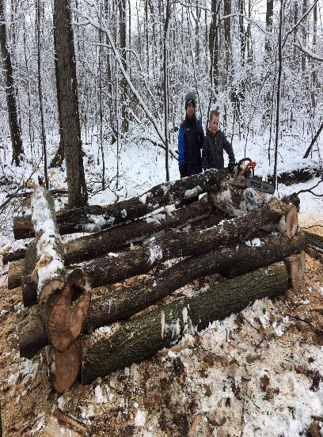
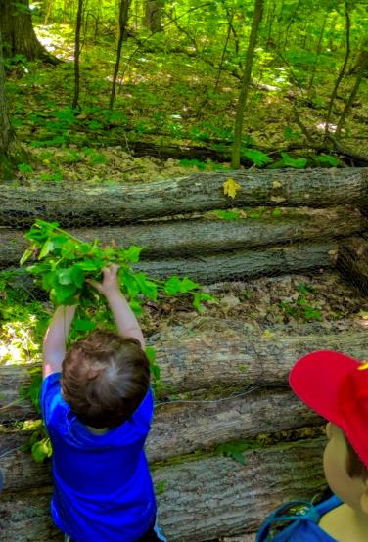
No Hauling Bags to local dump. Compost Bins built by Friends in Copeland

Slide 22
If you missed this year’s spring pull Join Next Year’s Spring Garlic Mustard Pull We can control garlic mustard. We can preserve the diversity of plants and trees we love in the Copeland Forest Let us know if you, your family, your friends are interested. Contact us at garlicmustard@copelandfriends.ca A wide range of dates and times will be available once again.

Slide 23
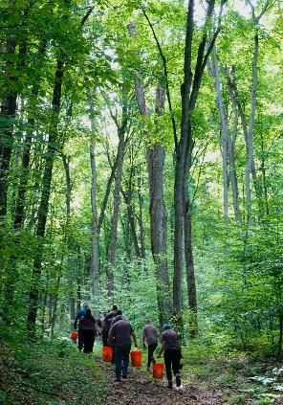
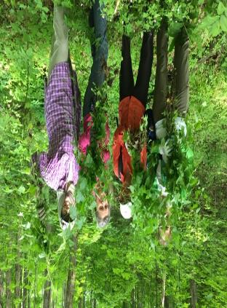
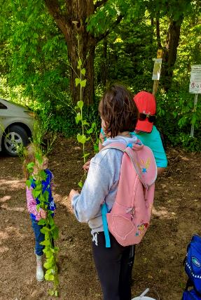
Everyone is Welcome at the Pull A Bonus: 🦎Discover nature’s surprises, large and small 🦎Enjoy garlic mustard snacks 🐸Feel pride in the Copeland Forest, Horseshoe Valley and District, and Simcoe County Community

Slide 24
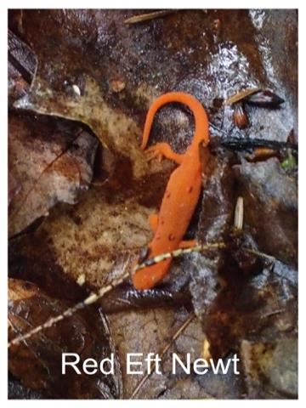
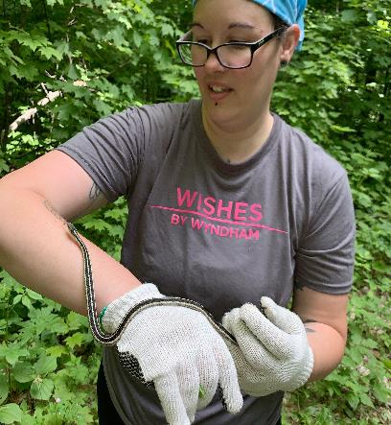
THANK YOU For protecting their habitat On behalf of creatures who live, often hidden from sight, in the Copeland
Garter Snake – 2019 Garlic MustardPull

Slide 25
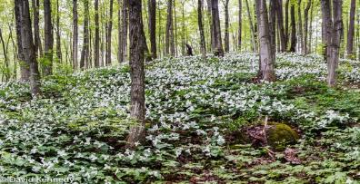
References for Garlic Mustard
A Landowner’s Guide to Managing and Controlling Invasive Plants in Ontario, Partnership of MNRF, OFAH,OIPC,CVC
GM, One of Ontario’s Most Unwanted Invasive Plants, Nottawasaga Valley Conservation Authority
Control Methods for the Invasive Plant Garlic Mustard within Ontario Natural Areas, Nature Conservancy of Canada, pdf
www.invadingspecies.com or www.ontarioinvasiveplants.ca
‘There’s no major city like it’: Toronto’s unique ravine system under threat, www.theguardian.com
Ready or Not, Garlic Mustard is Moving In: Alliaria petiolata as a Member of Eastern North American Forests; www.biosciencemag.org

